Slide 1
Master’s Thesis:
Topology optimization of flow configurations operating in the turbulent regime
Final presentation
June 26th 2026
Tiebert Lefebure (r0887630)
MSc Mechanical Engineering – Thermotechnical Sciences

Slide 2
Research Questions
How accurately does the Spalart-Allmaras turbulence model predict curved and separated internal turbulent flows, and where do its physical limitations appear?

Slide 3
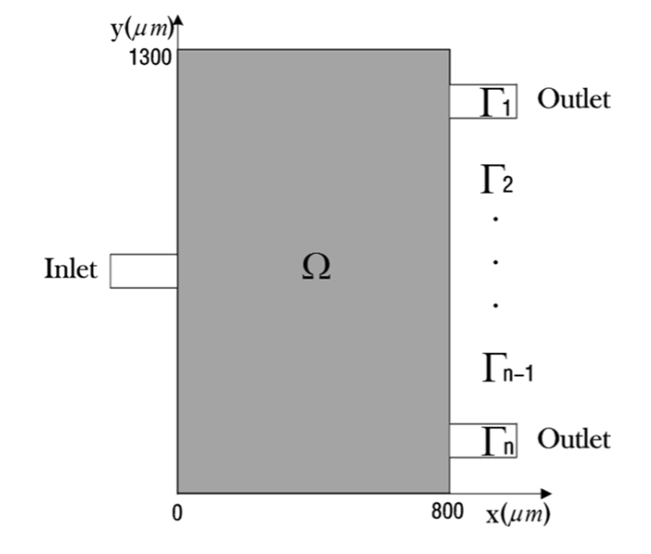
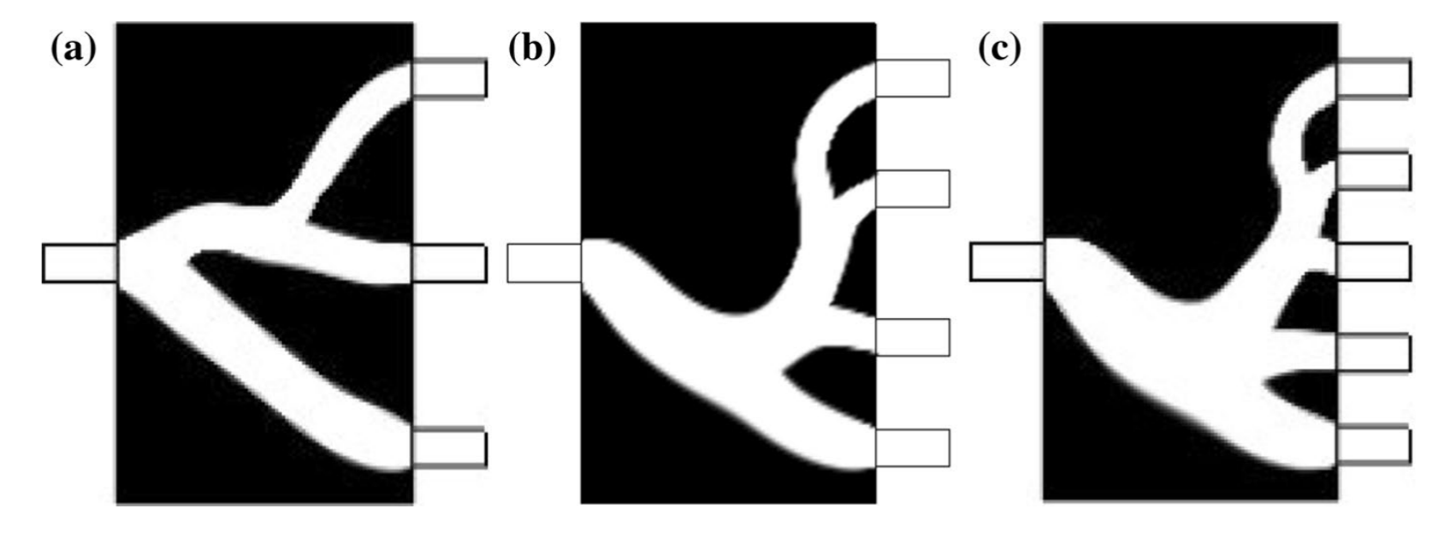
Motivation
What is topology optimization (TO)?
Design domain Ω
Optimal material layout
Design variable (e.g. density ρ)
Objective function J
[1] T. Zhou, T. Liu, Y. Deng, L. Chen, S. Qian, and Z. Liu, “Design of microfluidic channel networks with specified output flow rates using the CFD-based optimization method,” Microfluid Nanofluidics, vol. 21, no. 1, Jan. 2017, doi: 10.1007/s10404-016-1842-y.
Notes:
Topology optimization = numerical design method that determines the optimal material layout in a given design domain, for given loads, boundary conditions, and physics (fluid, heat, structural, multiphysics…).
The design domain is discretized (e.g., finite elements) and each element gets a design variable (like density). The algorithm iterates until it finds the material layout that optimizes an objective function.

Slide 4
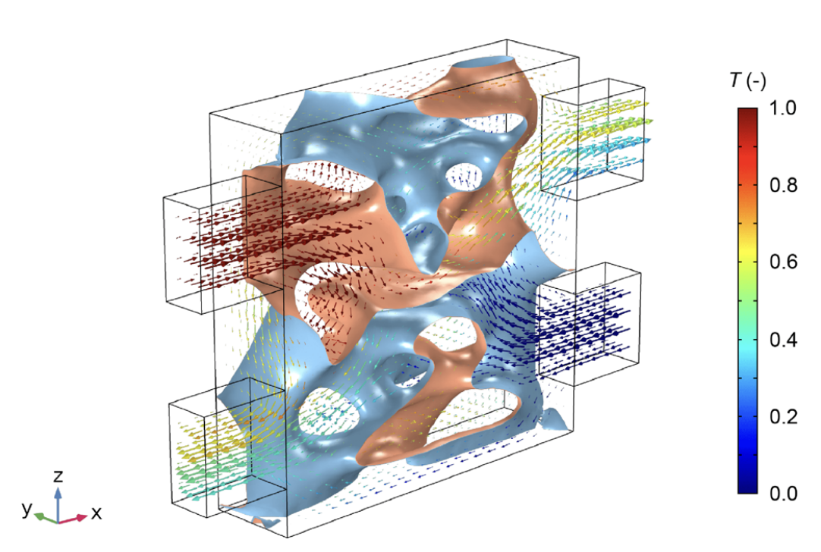
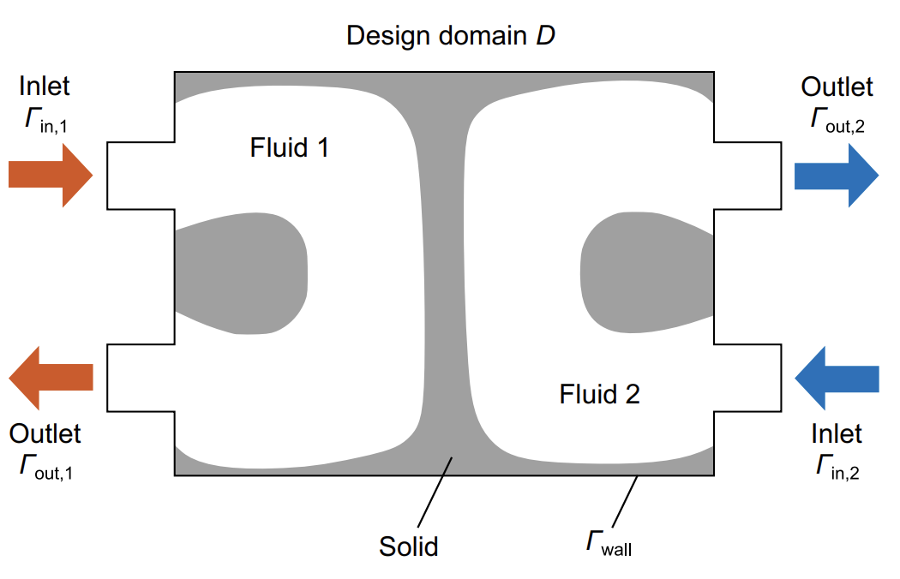
Motivation
Topology optimization of heat transfer applications (e.g. heat exchangers)
[2] H. Kobayashi, K. Yaji, S. Yamasaki, and K. Fujita, “Topology design of two-fluid heat exchange,” Structural and Multidisciplinary Optimization, vol. 63, no. 2, pp. 821–834, Feb. 2021, doi: 10.1007/s00158-020-02736-8.
Notes:
Topology optimization is ideal for heat-transfer problems because it can automatically create optimal conduction and convection pathways.
Heat-transfer problems often involve complex interactions between: conduction, convection, thermal-fluid coupling, pressure loss constraints, temperature-dependent material behavior.
These interactions are nonlinear and unintuitive, so manual design leads to suboptimal solutions.
Orange & blue indicate solid walls.

Slide 5
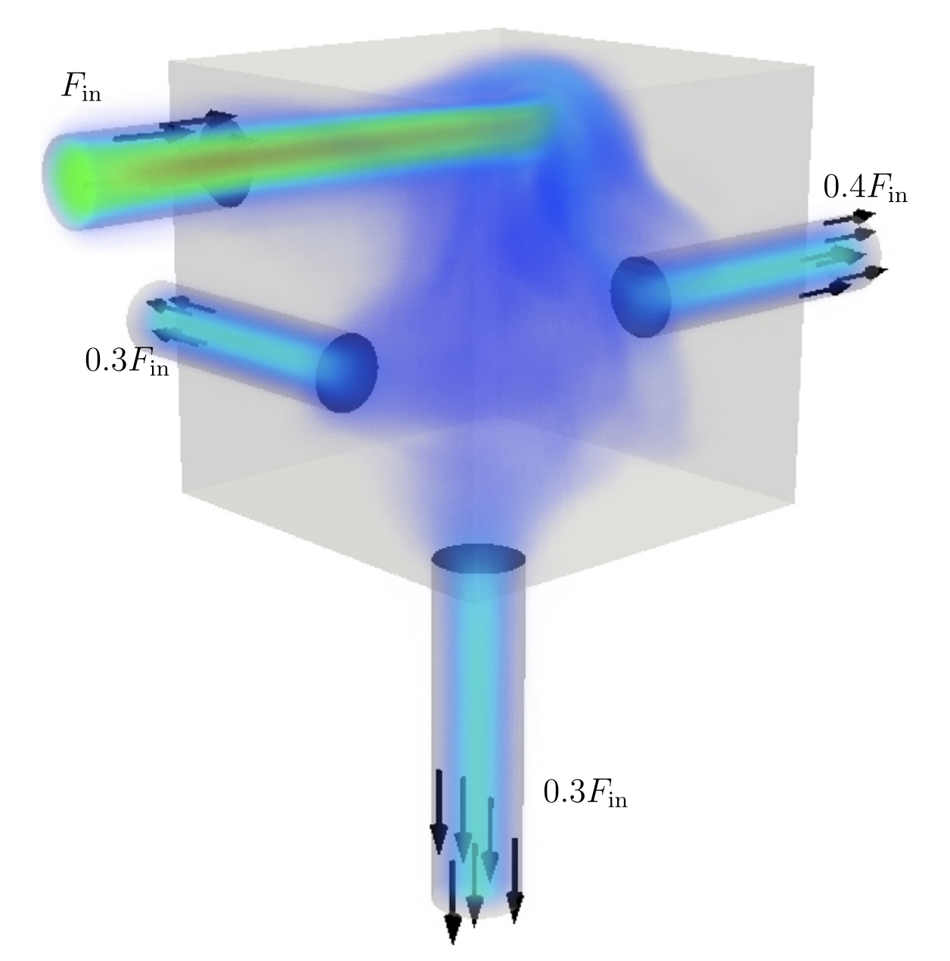
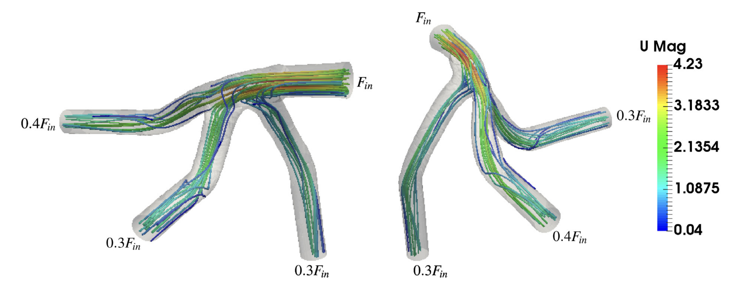
Motivation
Topology optimization of turbulent flow applications (e.g. manifolds)
[3] C. B. Dilgen, S. B. Dilgen, D. R. Fuhrman, O. Sigmund, and B. S. Lazarov, “Topology optimization of turbulent flows,” Comput Methods Appl Mech Eng, vol. 331, pp. 363–393, Apr. 2018, doi: 10.1016/j.cma.2017.11.029.
Notes:
Constrained mass flow rates at 3 outlets Cube = design domain

Slide 6
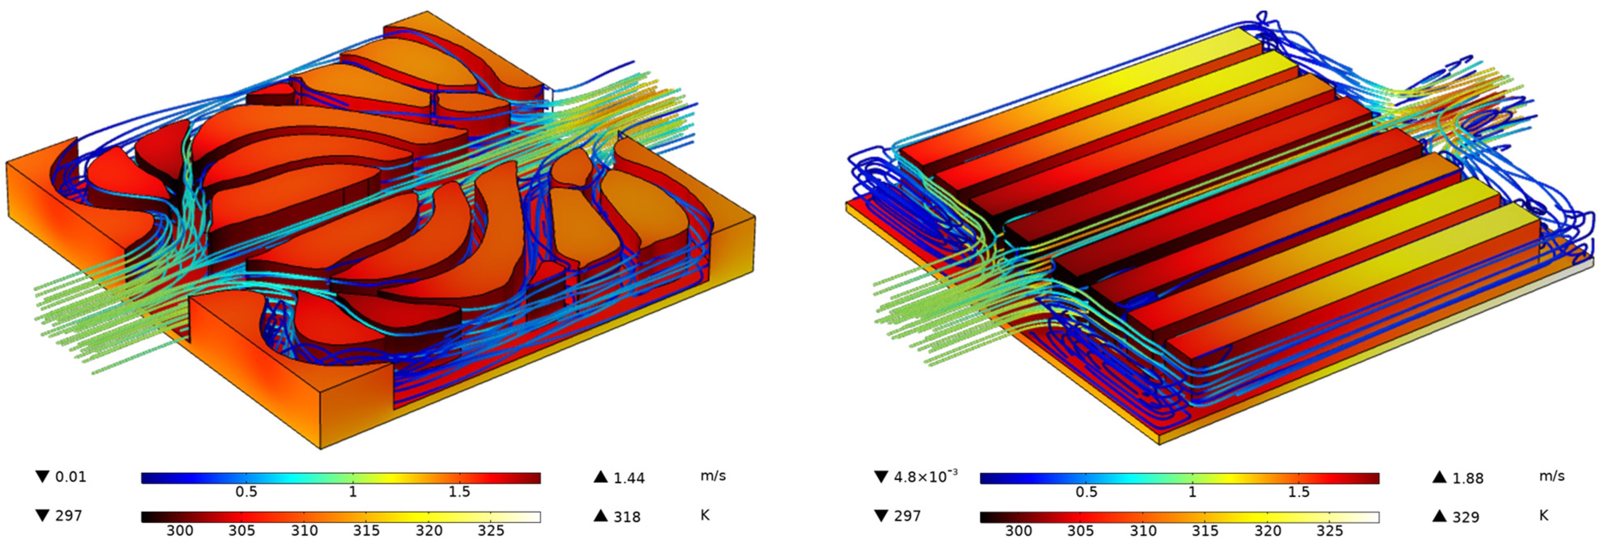
Motivation
Topology optimization of heat transfer applications operating in the turbulent regime (e.g. heat sinks)
Industry: forced convection, turbulence
Electronics cooling systems
Exploit turbulence to improve heat-transfer performance
[4] Sun Y, Hao M, Wang Z. Topology Optimization of Turbulent Flow Cooling Structures Based on the k-ε Model. Entropy. 2023; 25(9):1299. https://doi.org/10.3390/e25091299
Notes:
TO can systematically create geometries that exploit turbulence rather than fight it.
TO treats turbulence as a design tool, not a nuisance.
Higher power density Topology optimized design for heat sink: more uniform temperature distribution, less kinetic energy losses (vortices), even distribution of fluid in flow channels <-> straight channels
K-epsilon turbulence model

Slide 7
Research objective
Extending the application of topology optimization (TO) to the design of devices with turbulent flow and heat transfer
Developing the TO framework in FEniCS for turbulent flow using the Spalart-Allmaras turbulence model
Extending the TO framework in FEniCS for turbulent conjugate heat transfer problems
Validating the optimized designs (in ANSYS) for both flow-only and flow-plus-heat-transfer conditions

Slide 8
Research questions
For which benchmark turbulent flows (implemented in ANSYS) does the Spalart–Allmaras turbulence model provide sufficient accuracy, and where does it begin to fail?
Can a FEniCS implementation of the Spalart–Allmaras model reproduce reliable results for standard turbulent flow cases?
Does topology optimization using the Spalart–Allmaras model yield physically meaningful and robust turbulent flow designs?
Can topology optimization with SA be extended to turbulent conjugate heat-transfer problems while maintaining reliable performance?

Slide 9
Content
Motivation, research objective & research questions
Benchmark turbulent flow cases in Ansys
Introduction to turbulence modelling and FEniCS
Benchmark turbulent flow cases in FEniCS
Topology optimization in FEniCS
Timeline and summary

Slide 10
Content
Motivation, research objective & research questions
Benchmark turbulent flow cases in Ansys
Introduction to turbulence modelling and FEniCS
Benchmark turbulent flow cases in FEniCS
Topology optimization in FEniCS
Timeline and summary

Slide 11
Research questions
For which benchmark turbulent flows (implemented in ANSYS) does the Spalart–Allmaras turbulence model provide sufficient accuracy, and where does it begin to fail?
Can a FEniCS implementation of the Spalart–Allmaras model reproduce reliable results for standard turbulent flow cases?
Does topology optimization using the Spalart–Allmaras model yield physically meaningful and robust turbulent flow designs?
Can topology optimization with SA be extended to turbulent conjugate heat-transfer problems while maintaining reliable performance?

Slide 12
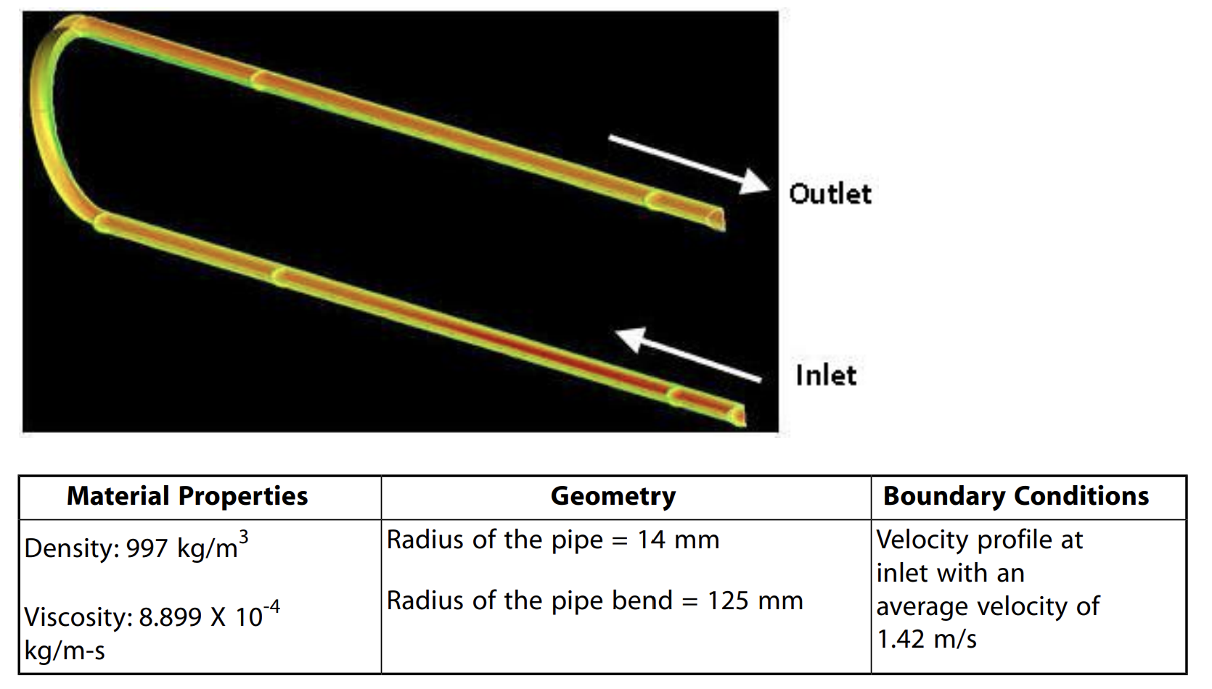
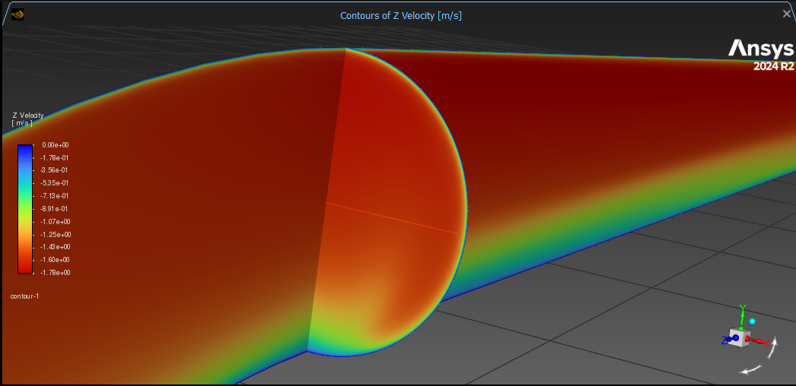
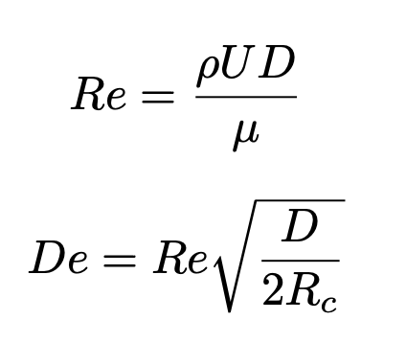
3D U-bend (VMFL048)
Reynolds number: Re_{D} = 44.000
Mean radius of curvature: R_{c} = 4,5*D
Dean number: De = 15.000
Plane at U-bend exit (SST k-ω)
[5] Ansys Fluid Dynamics Verification Manual, Release 2024 R1
[6] T. Takamasa, A. Tomiyama. "Three-dimensional gas-liquid two-phase bubbly flow in a C-shaped tube". NURETH-9. San Francisco, USA. pp. 1-17. 1999.

Slide 13
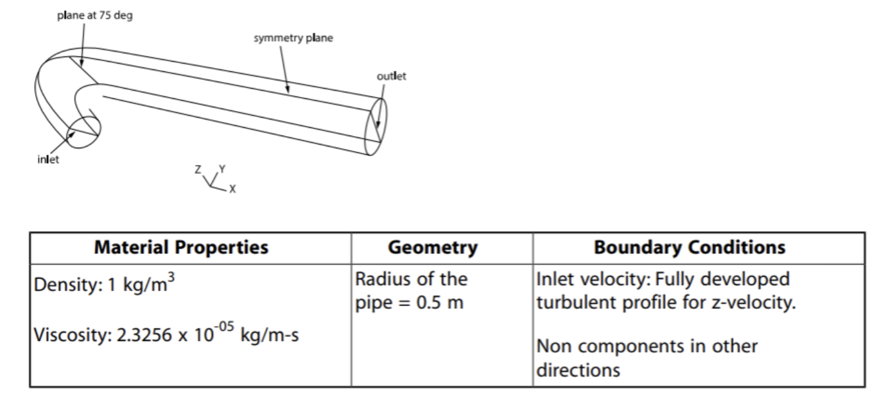
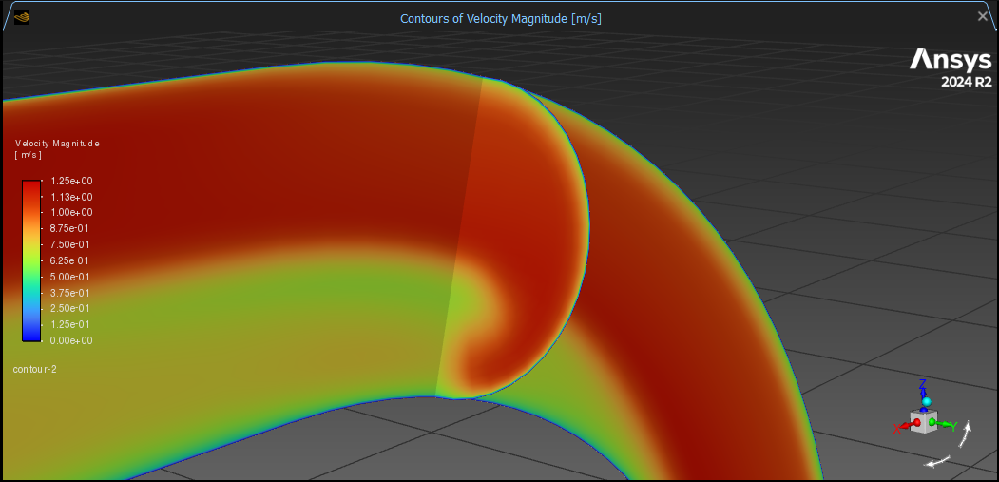
3D 90°-bend (VMFL030)
Reynolds number: Re_{D} = 43.000
Mean radius of curvature: R_{c} = 2,8*D
Dean number: De = 18.000
Plane at 75° along bend (RNG k-ε)
[5] Ansys Fluid Dynamics Verification Manual, Release 2024 R1
[7] M.M. Enayet, M.M. Gibson, A.M.K.P. Taylor, M. Yianneskis,“Laser-Doppler Measurements of Laminar and Turbulent Flow in a Pipe Bend”. Znt. J. Heat & Fluid Flow, Vol 3. pp. 213-219, 1982

Slide 14
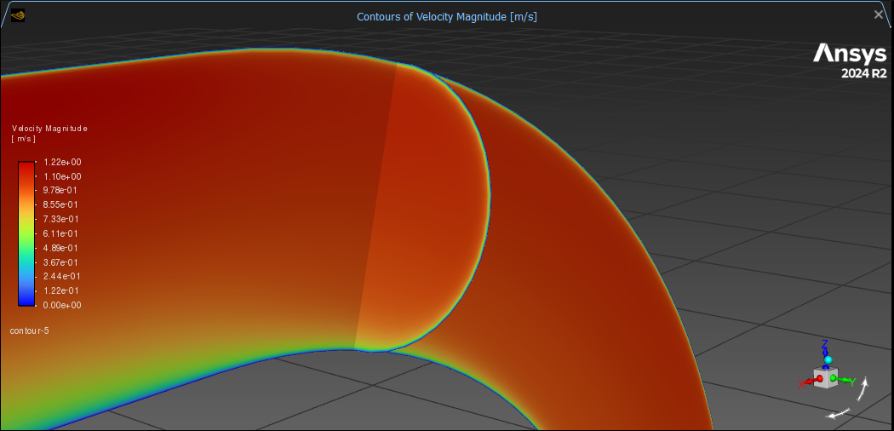
Limits of Spalart-Allmaras turbulence model
90°-bend: Dean number De ≈ 2x higher
Strong separation zones, Dean vortices
Spalart-Allmaras model clearly fails
SA model calibrated for attached/mildly curved boundary layers
90°-bend: SA overpredicts turbulent mixing
No strict numerical De limit: flow features more important
SA assumptions break down: use k-ω, k-ε, ...
Plane at 75° along bend (SA)
Notes:
Overpredicting mixing means that the SA model generates too much turbulent viscosity, causing excessive momentum diffusion.
This smooths out velocity gradients, weakens or eliminates recirculation zones, and exaggerates secondary flows such as Dean vortices.
Spalart–Allmaras is calibrated for attached aerodynamic boundary layers, not for flows dominated by: curvature-induced secondary flows, large separation zones, swirl and turning effects.
So it tends to diffuse momentum too aggressively, “mixing” the flow more than reality.

Slide 15
Influence of Reynolds number – 90°-bend
Influence on flow profile shape

Slide 16
Influence of Reynolds number – 90°-bend
Difference between SA and SST k-ω turbulence models
Low Re: transitional effects, SA is less accurate
SA and SST k-ω predict onset of turbulence differently
High Re: fully turbulent flow, models converge
Absolute difference grows with increasing Re
Increasing mean flow speed
Notes:
Fully turbulent boundary layers
At y = 0,6-0,8: strong curvature effects Absolute difference grows + SST velocity shows a dip

Slide 17
Influence of Reynolds number – U-bend
Difference between SA and SST k-ω turbulence models
Low Re: transitional effects, SA (wrongly) assumes fully turbulent flow everywhere
High Re: fully turbulent boundary layers, models predict similar turbulent behaviour

Slide 18
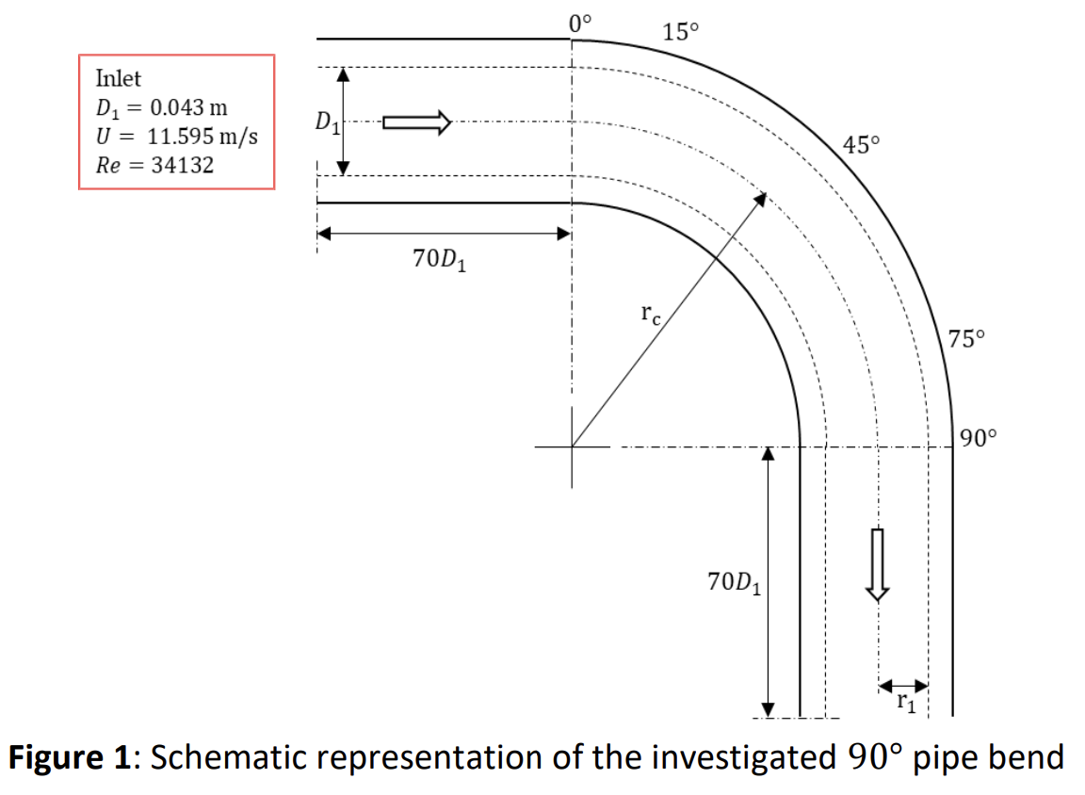
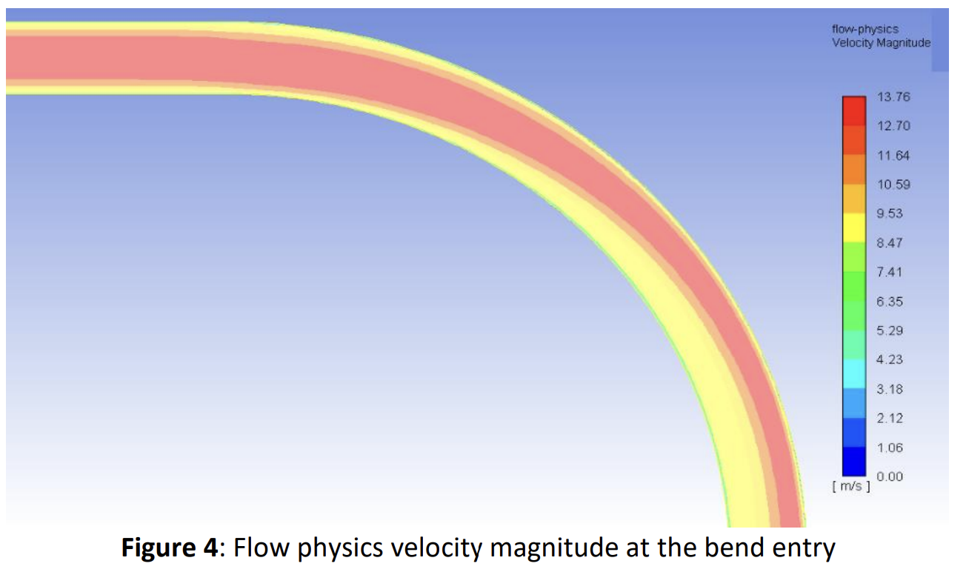
Literature review – mild curvature
Comparison with reference data – low De (~ ANSYS U-bend)
Re_{D} = 34.000
R_{c} = 7*D
De = 9.000
Inner wall: separation, recirculation, decelerated flow
Outer wall: curvature-induced accelerated flow
[8] R. K. Apalowo (2022). Numerical Study of Different Models for Turbulent Flow in 90° Pipe Bend. U.Porto Journal of Engineering, DOI: 10.24840/2183-6493_008.002_0010.

Slide 19
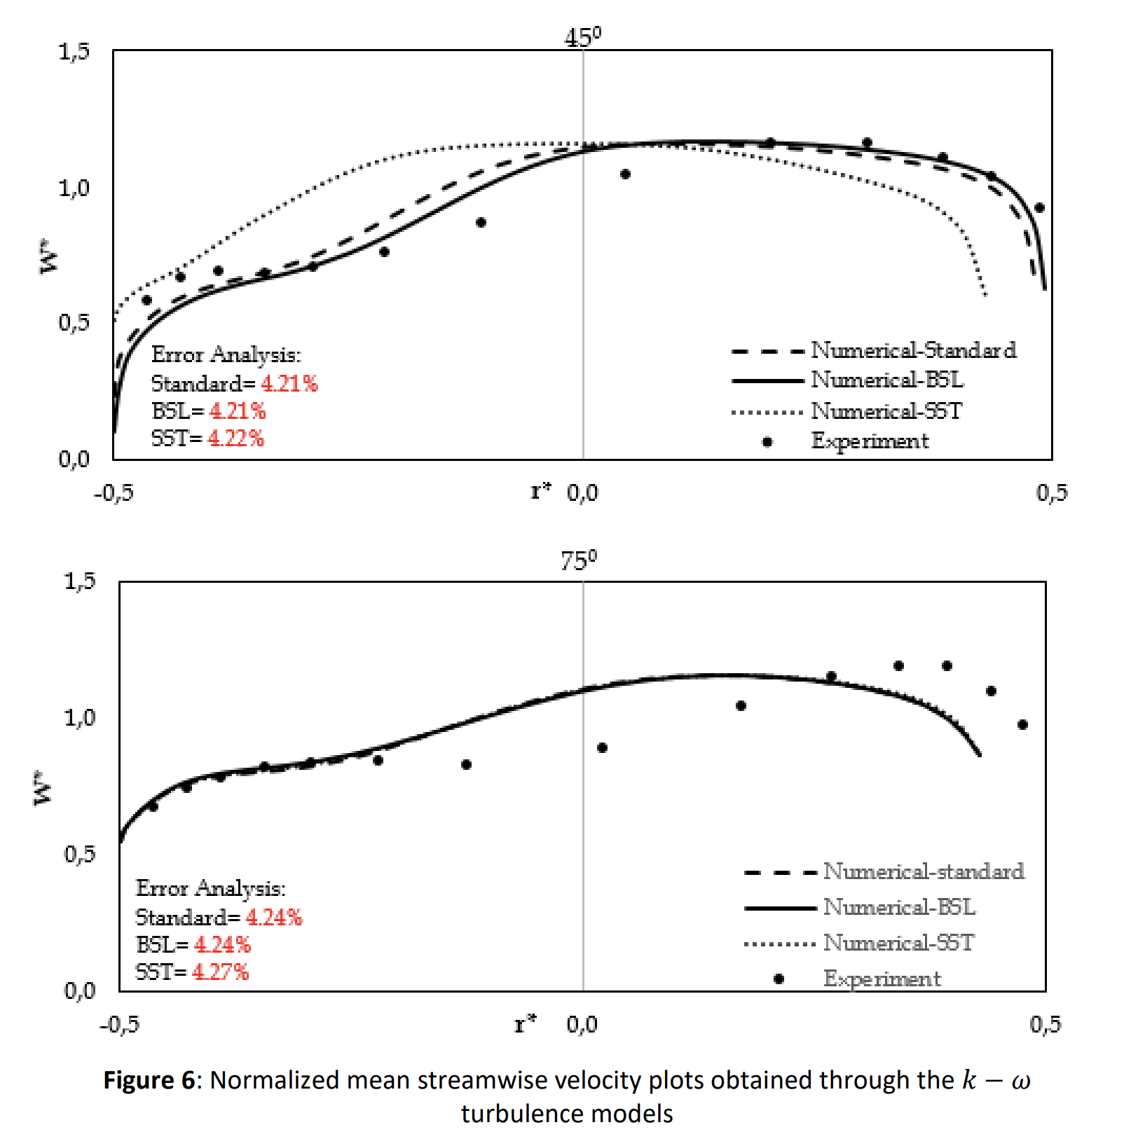
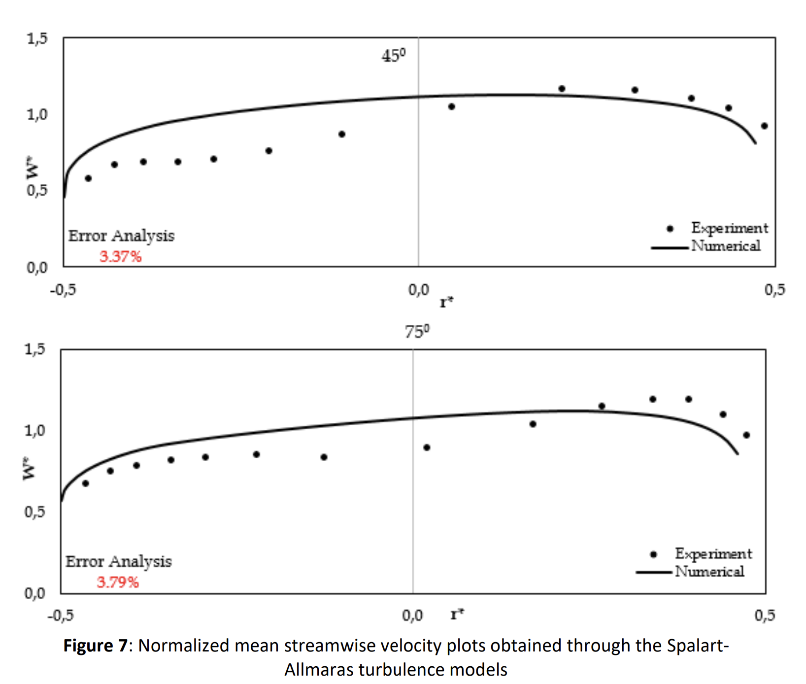
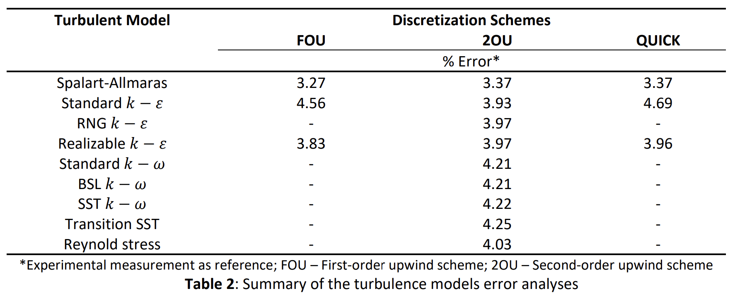
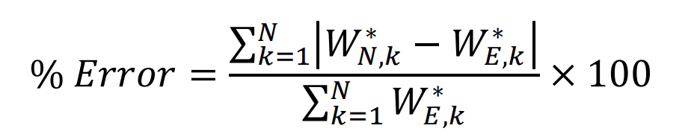
Literature review – mild curvature
Normalized mean streamwise velocities at 45°/75° along bend
SA outperforms k-ω in terms of average % error
SA performs relatively well for this mildly curved turbulent flow

Slide 20
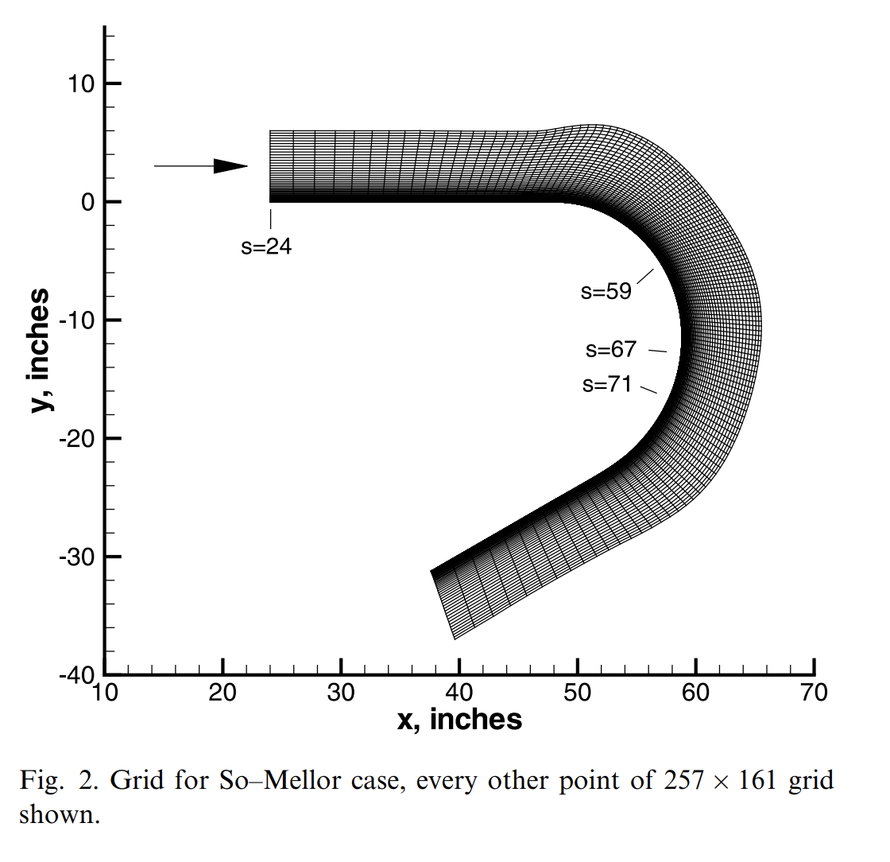
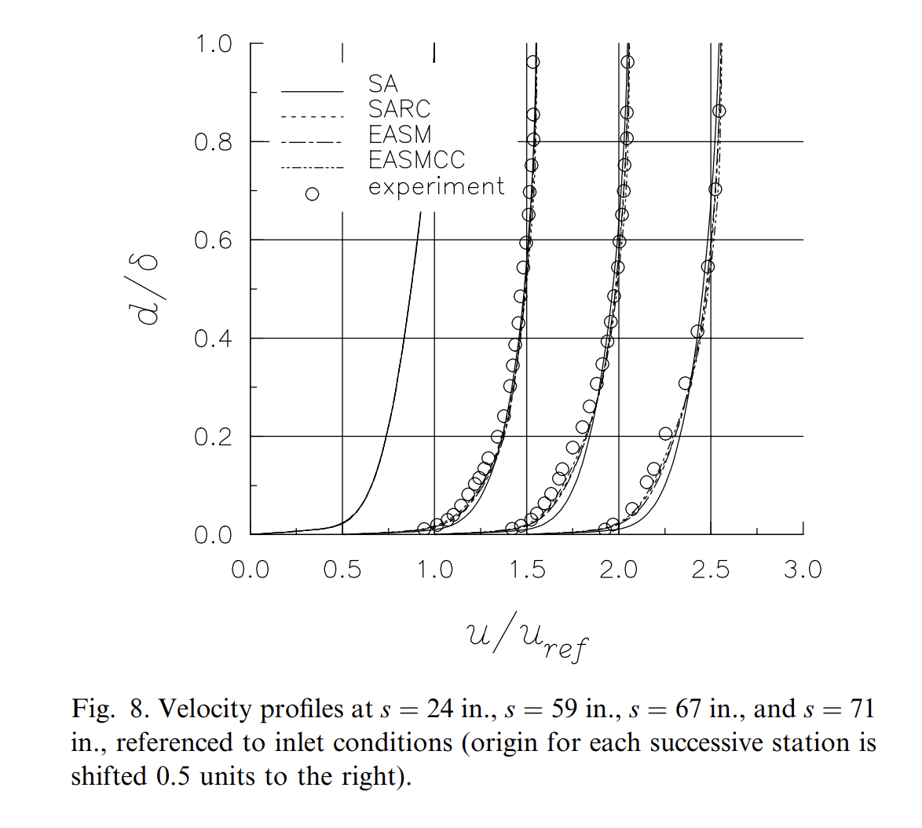
Literature review – strong curvature
Comparison with reference data – high De (~ ANSYS 90°-bend)
SA velocity profiles are "too full" (first 20% of b.l.)
SA weakens velocity gradients
Re_{D} = 100.000
R_{c} = 2*D
De = 50.000
[9] Rumsey, Christopher & Gatski, T. & Anderson, Kyle & Nielsen, Eric. (2001). Isolating curvature effects in computing wall-bounded turbulent flows. International Journal of Heat and Fluid Flow. 22. 573-582. 10.1016/S0142-727X(01)00122-9.
Notes:
SA produces too much eddy viscosity in curved or separating flows, it over-diffuses momentum, making the boundary layer fuller and reducing velocity gradients.

Slide 21
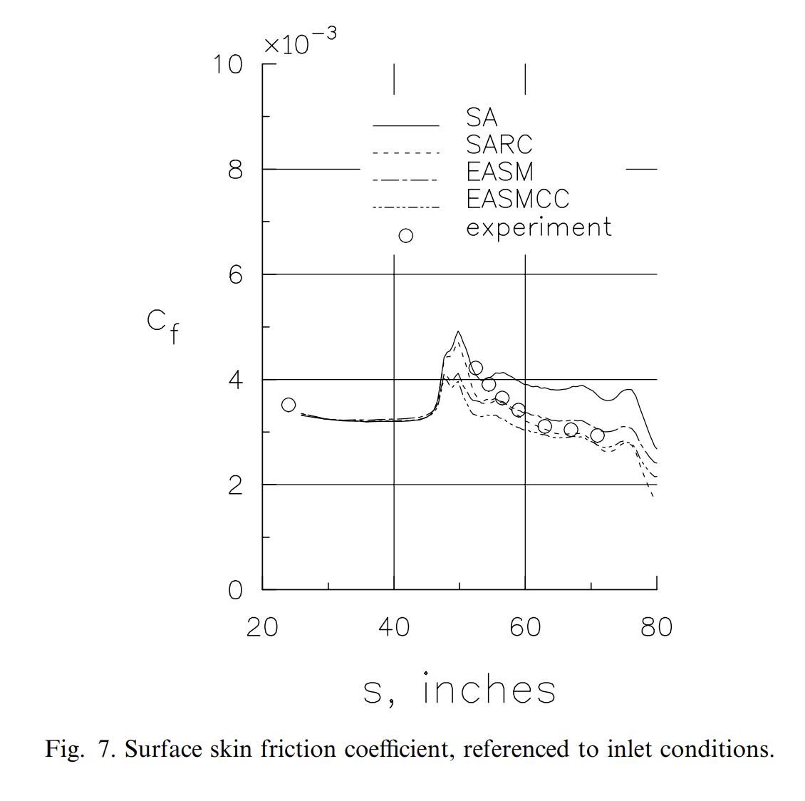
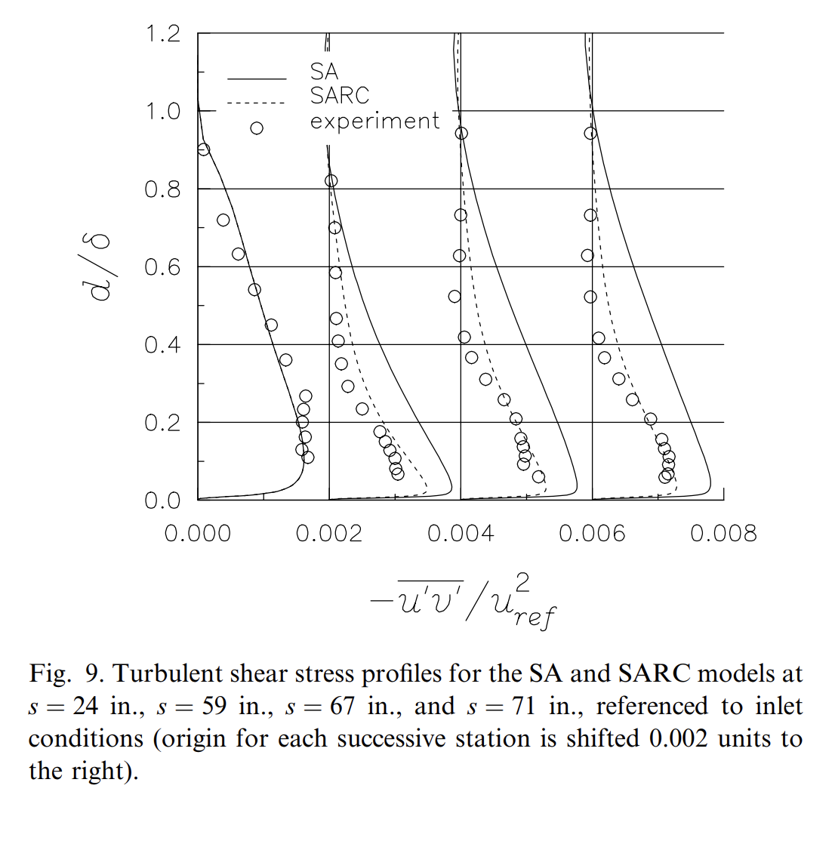
Literature review – strong curvature
SA overpredicts turbulent viscosity under strong curvature
Artificially high wall-shear on outer wall (only along bend)
SA underpredicts Dean vortices (anisotropy not modelled)
Notes:
SA produces too much turbulent viscosity.
This increases momentum transport toward the wall → steeper near-wall velocity gradient → higher wall shear stress on that wall section. SA overpredicts streamwise turbulent viscosity → too high skin friction on outer wall
SA cannot model turbulence anisotropy (SA assumes isotropic eddy viscosity) → underpredicts curvature-induced secondary flows
This figure shows that the standard Spalart–Allmaras model systematically underpredicts turbulent shear stress in strongly curved flows, whereas curvature-corrected variants recover the experimentally observed momentum redistribution.

Slide 22
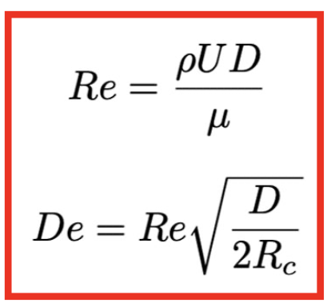
Research questions
For which benchmark turbulent flows (implemented in ANSYS) does the Spalart–Allmaras turbulence model provide sufficient accuracy, and where does it begin to fail?
De not too high (upper limit De ≈ 10.000 in this study)
R_{c}/D ratio large enough (lower limit R_{c}/D ≈ 5 in this geometry)
Re high enough for fully turbulent flow (no laminar/transitional regions)
"The Spalart–Allmaras turbulence model is reliable mainly for fully turbulent flows with mild curvature, losing accuracy as Dean number and curvature intensity increase."
Notes:
“Reynolds number high enough for fully turbulent flow (no laminar/transitional regions) — in this geometry, Re based on D: Re_D ≳ O(10⁴).”

Slide 23
Content
Motivation, research objective & research questions
Benchmark turbulent flow cases in Ansys
Introduction to turbulence modelling and FEniCS
Benchmark turbulent flow cases in FEniCS
Topology optimization in FEniCS
Timeline and summary

Slide 24
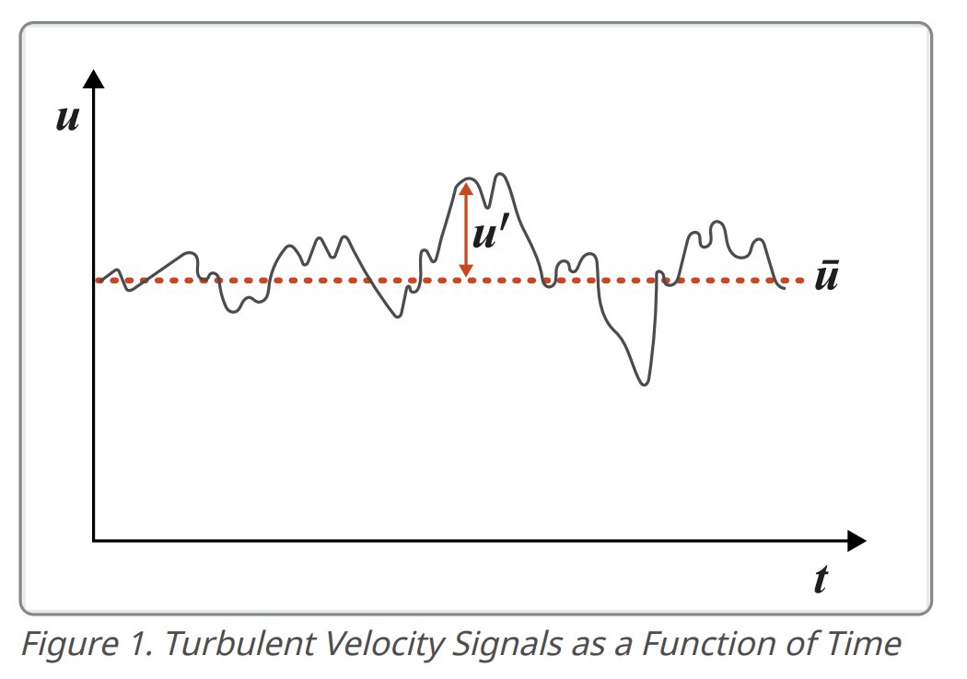
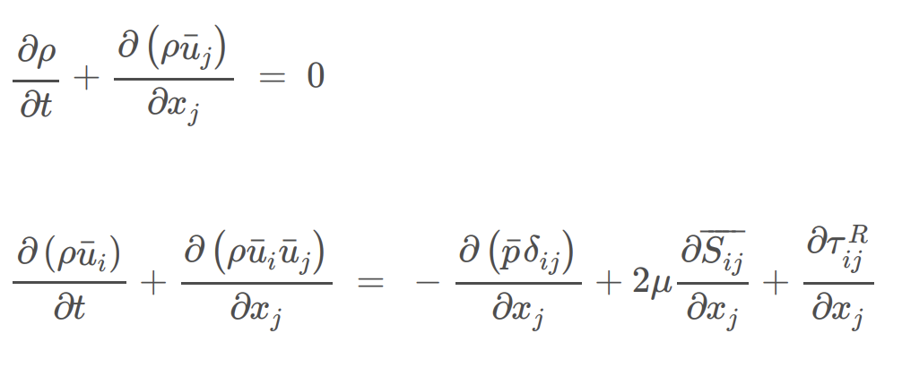
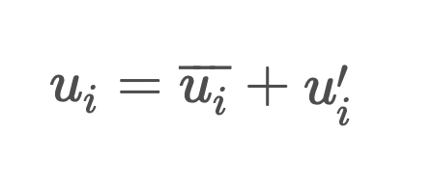
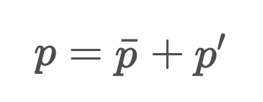
Reynolds-Averaged Navier-Stokes equations (RANS)
Incompressible turbulent flow: Reynolds' decomposition
Reynolds-averaged continuity equation
Reynolds-averaged momentum equations
[10] https://help.altair.com/hwcfdsolvers/acusolve/topics/acusolve/training_manual/turb_modeling_r.htm
Notes:
For incompressible turbulent flow the instantaneous velocity field can be decomposed into a time averaged velocity and its corresponding fluctuation.
= Reynolds’ decomposition.
Instantaneous pressure can be decomposed into the time averaged and fluctuation terms.
Concept is substituted into the instantaneous Navier-Stokes equations and then time averaging is performed --> RANS equations
S_ij = mean strain rate tensor; tau_ij = Reynolds stress tensor

Slide 25
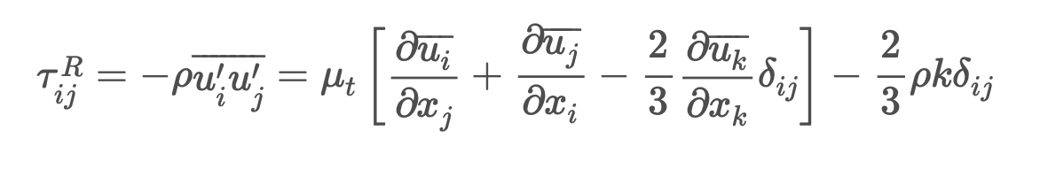
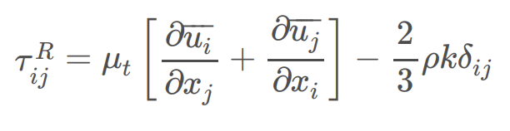
Reynolds stress tensor
Closure problem of turbulence
Boussinesq approximation + incompressible flow:
Eddy viscosity μ_{t} is only unknown (determined by turbulence model)
Examples: Spalart-Allmaras, k-ε, k-ω, ...
Notes:
Reynolds-averaging eliminates a need to compute the instantaneous flow field, but introduces a new unknown term in comparison to the Navier-Stokes equations.
Reynolds stress tensor, which represents an added stress due to the turbulent motions. k = turbulent kinetic energy per unit mass
Eliminate any dependence on instantaneous flow field in these simplified equations, this term should be modeled in terms of the mean flow = turbulence closure problem
Boussinesq approximation = linear relationship between the turbulent Reynolds stresses and the mean rate of strain tensor.

Slide 26
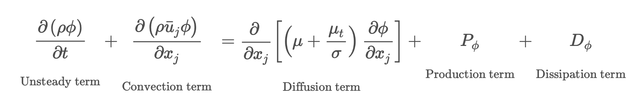
Turbulence models
General form:
Solve for turbulence model variable ϕ
Compute eddy viscosity μ_{t}
Notes:
The left-hand side of the equation describes advection, which includes two terms, the acceleration term and convective term. The unsteady term represents the time-dependence of turbulence model variables, while the convective term accounts for the rate of change of variables due to convection by the mean flow. The diffusion term describes the transport of turbulent variables due to the summation of material viscosity and eddy viscosity. The production term indicates the production rate of turbulent variables from the mean flow gradient, while the dissipation term represents the dissipation rate of turbulent variables due to viscous stresses.

Slide 27
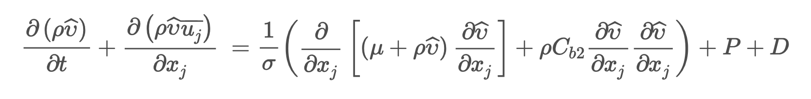
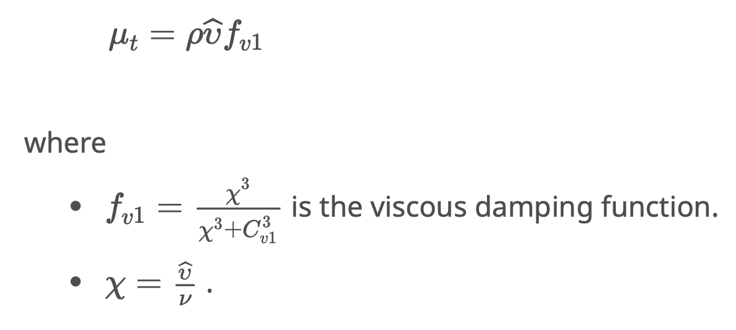
Spalart-Allmaras turbulence model
One-equation turbulence model
Transport equation to solve for modified kinematic eddy viscosity:
Eddy viscosity μ_{t}

Slide 28

FEniCS Project
Open-source platform for solving PDEs with Finite Element Method (FEM)
High-level Python interface
Weak formulation of PDEs
[11] https://fenicsproject.org/
Notes:
Open-source computing platform

Slide 29
Implementation of NS equations in FEniCS
GitHub repository: https://github.com/BanVacc/CFD_FEniCS
Discretize momentum equations: Chorin's projection method
Enforces continuity equation exactly
1) Ignore pressure term, solve momentum equations for u*
​2) Solve pressure Poisson equation for pressure field p
3) Correct u* by updating it with obtained pressure field p
[12] https://github.com/BanVacc/CFD_FEniCS
[13] https://olddocs.fenicsproject.org/dolfin/1.4.0/python/demo/documented/navier-stokes/python/documentation.html
Notes:
"Decoupling" of pressure and velocity into 3 distinct linear steps

Slide 30
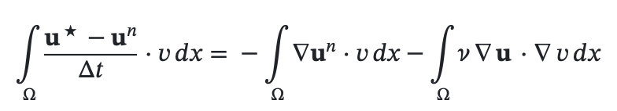
Implementation of NS equations in FEniCS
Solving PDEs in FEniCS: representation in weak form
Test function v
FEM to discretize problem and obtain numerical solution
E.g. first step of Chorin's projection method in weak form:
Notes:
Choose a test function v from a suitable function space V, u = "trial function" from same function space V Integrate both sides over computational domain Ω Whenever you have second derivatives (e.g. Laplacian), integration by parts reduces the derivative order on u, transferring one derivative to the test function v Weak forms require only first derivatives of u, it ensures existence of solutions even with non-smooth fields (important in turbulence), it naturally introduces Neumann boundary terms.

Slide 31
Content
Motivation, research objective & research questions
Benchmark turbulent flow cases in Ansys
Introduction to turbulence modelling and FEniCS
Benchmark turbulent flow cases in FEniCS
Topology optimization in FEniCS
Timeline and summary

Slide 32
Research questions
For which benchmark turbulent flows (implemented in ANSYS) does the Spalart–Allmaras turbulence model provide sufficient accuracy, and where does it begin to fail?
Can a FEniCS implementation of the Spalart–Allmaras model reproduce reliable results for standard turbulent flow cases?
Does topology optimization using the Spalart–Allmaras model yield physically meaningful and robust turbulent flow designs?
Can topology optimization with SA be extended to turbulent conjugate heat-transfer problems while maintaining reliable performance?

Slide 33
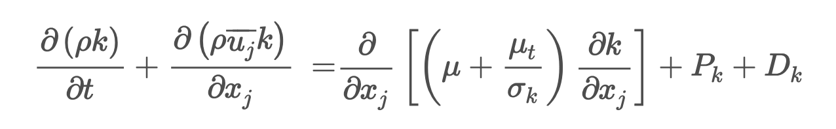
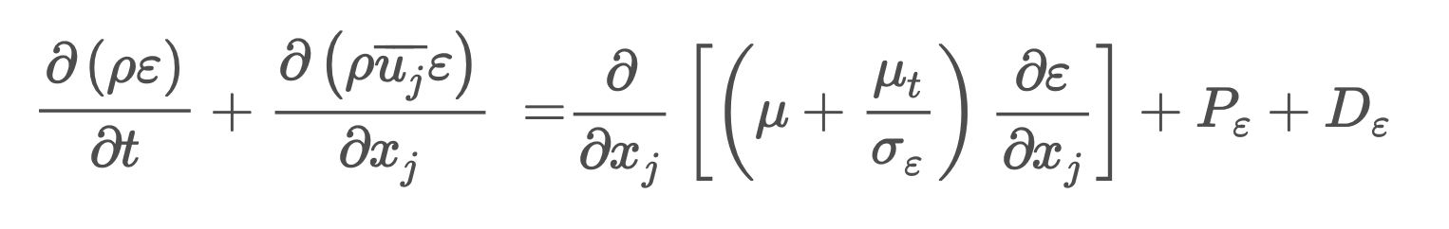
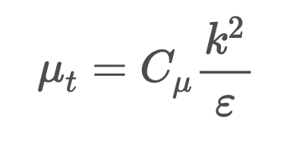
Implementation of k-ε model in FEniCS
Mortensen et al. (2013): standard k-ε turbulence model
Transport equations for k and ε:
Eddy viscosity:
[14] Valen-Sendstad, Kristian & Mortensen, Mikael & Langtangen, Hans Petter & Reif, Bjørn & Mardal, Kent-Andre. (2013). Implementing a k-epsilon Turbulence Model in the FEniCS Finite Element Programming Environment.
Notes:
Wall functions model the near-wall region without resolving the viscous sublayer by bridging the solution between the fully turbulent outer flow and empirical logarithmic laws near the wall. They allow much coarser meshes by avoiding extremely small y+ values, reducing computational cost while approximating wall shear stress and heat flux through empirical correlations.
They impose logarithmic or semi-empirical relations for velocity, k, and ε (or ω) at the first off-wall cell, instead of solving the full PDEs down to the wall.

Slide 34
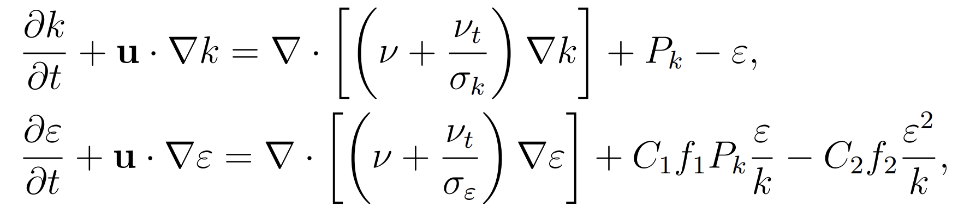
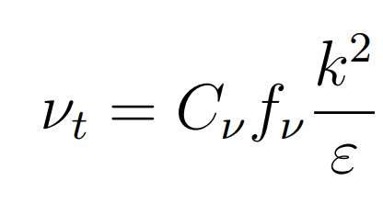
Implementation of k-ε model in FEniCS
GitHub repository: https://github.com/joove123/k-epsilon
Lam-Bremhorst k-ε turbulence model (low-Re corrections)
Modified transport equations for k and ε:
Modified eddy viscosity:
[15] https://github.com/joove123/k-epsilon
[16] Marcibal, J. (2024). Turbulence modeling in computational fluid dynamics. University of Southern Denmark.
Notes:
Lam & Bremhorst introduced low-Reynolds-number corrections to allow integration all the way to the wall without wall functions. Resolve low-Re boundary layers without wall functions. They modify: the eddy-viscosity definition, the ε-equation, the damping of turbulence production, additional viscous damping terms near the wall.
This is the most important difference: turbulence is strongly suppressed near the wall.

Slide 35
Implementation of k-ε model in FEniCS
Benchmark case 1: 2D fully developed channel flow
Lam-Bremhorst k-ε model
Solver strategy: pseudo-transient RANS solver (dynamic time-stepping)
Numerical scheme: segregated splitting ("decoupled" approach)
MUMPS direct solver
Turbulence coupling: segregated
Notes:
Time-marching to steady-state Direct solver requires a lot of RAM (scales with O(N^2)), slow for large problems Pressure-driven flow (inlet & outlet pressure BC), zero-velocity at wall, zero-k at wall

Slide 36
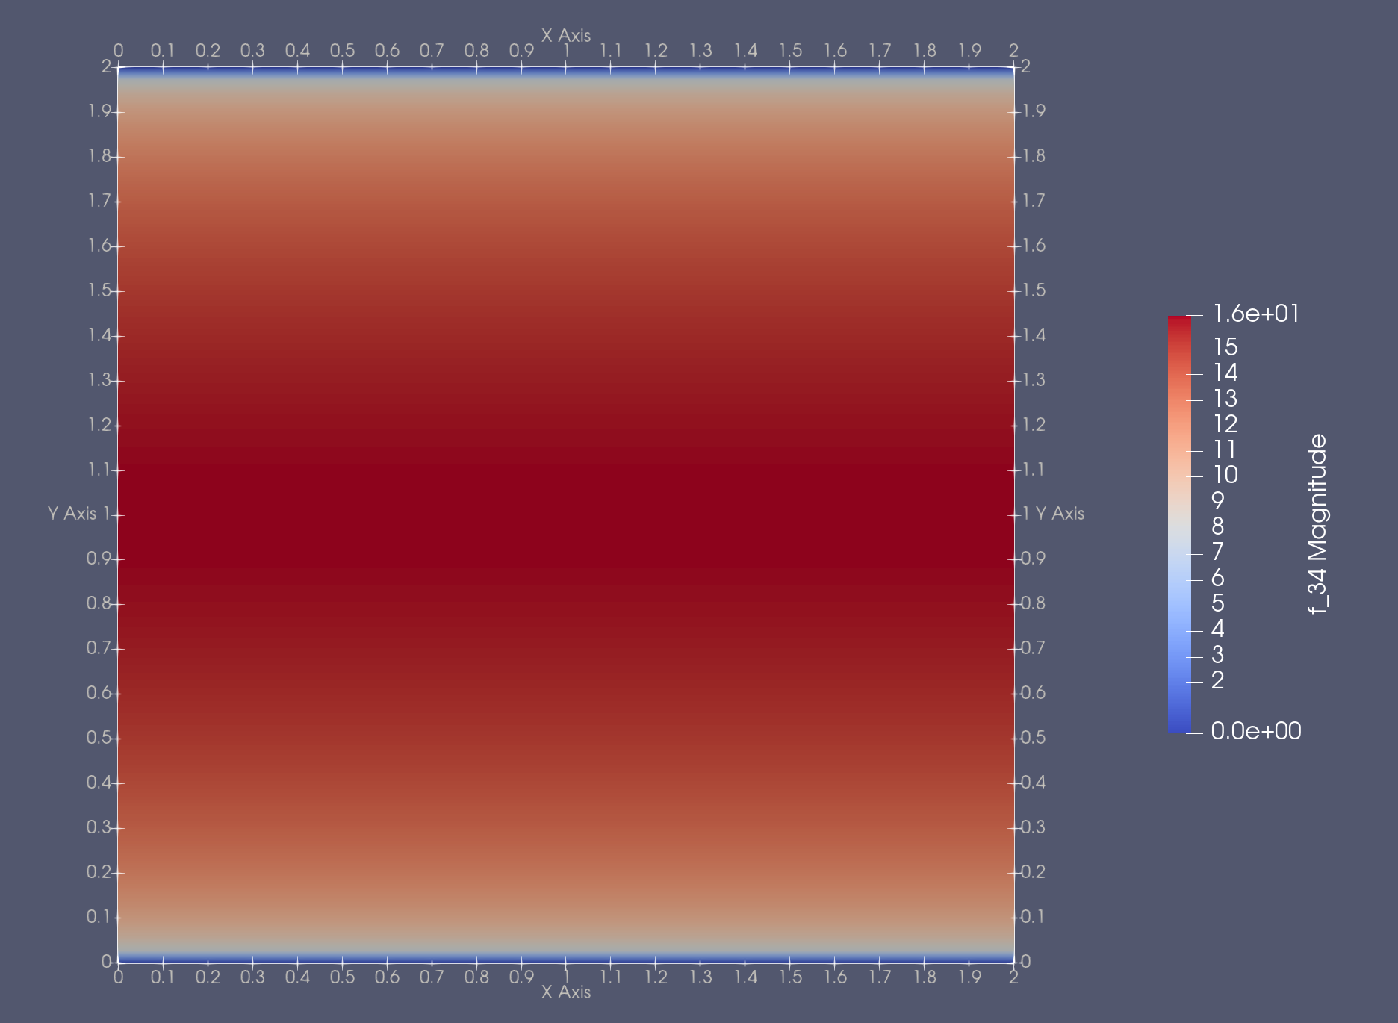
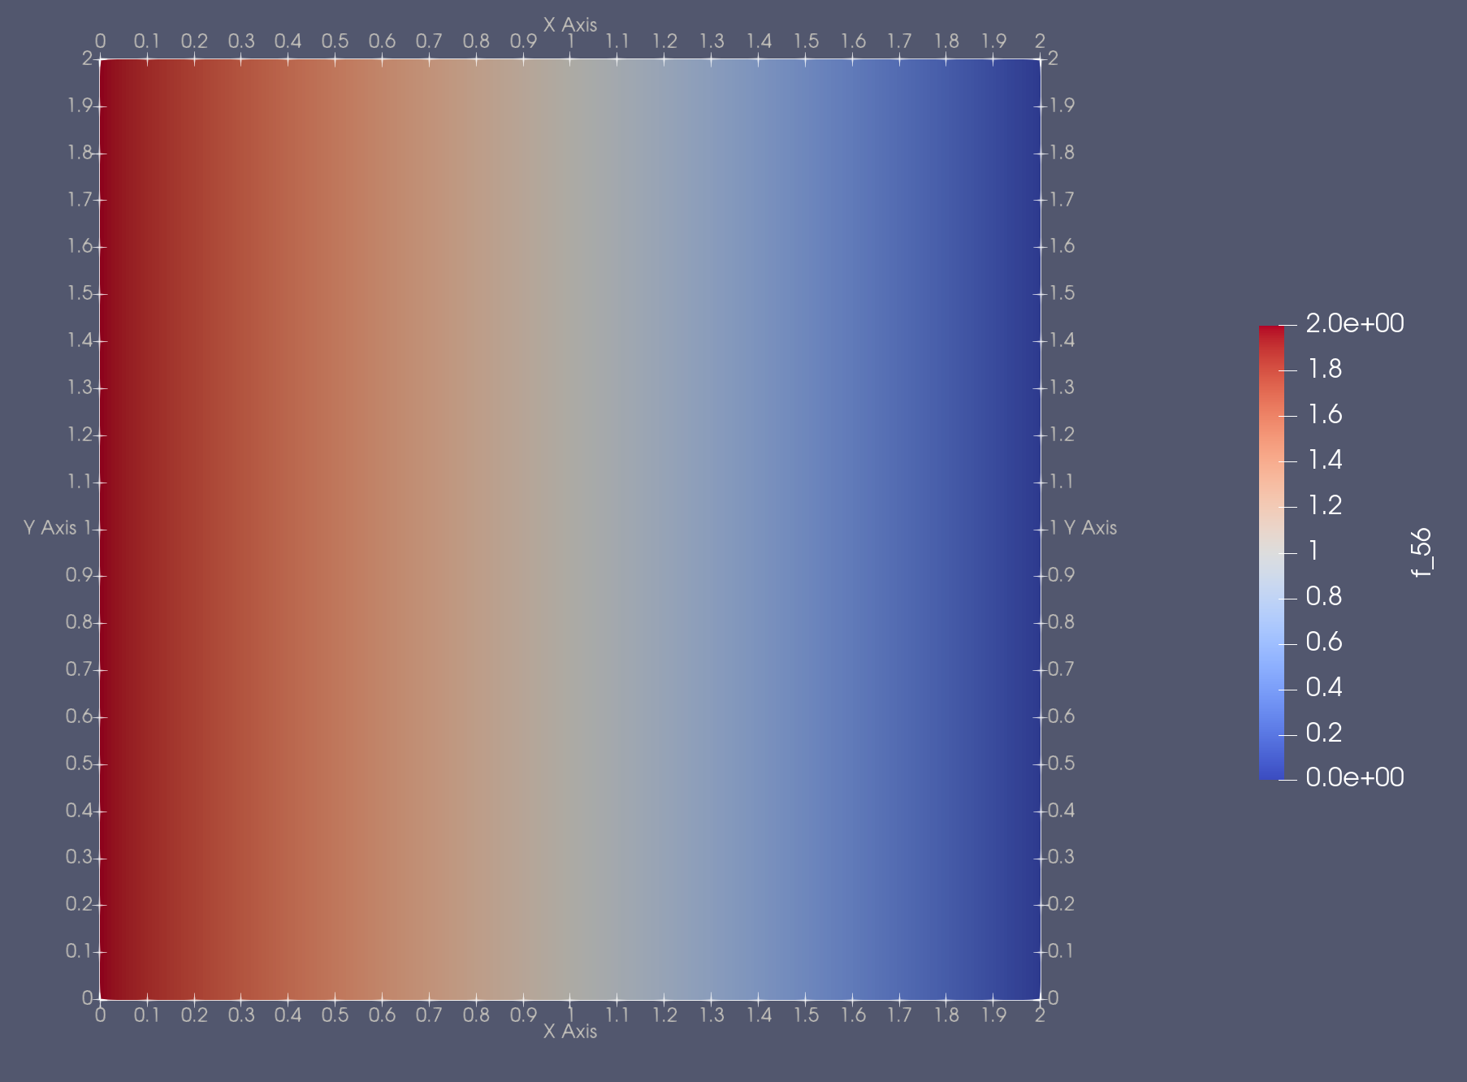
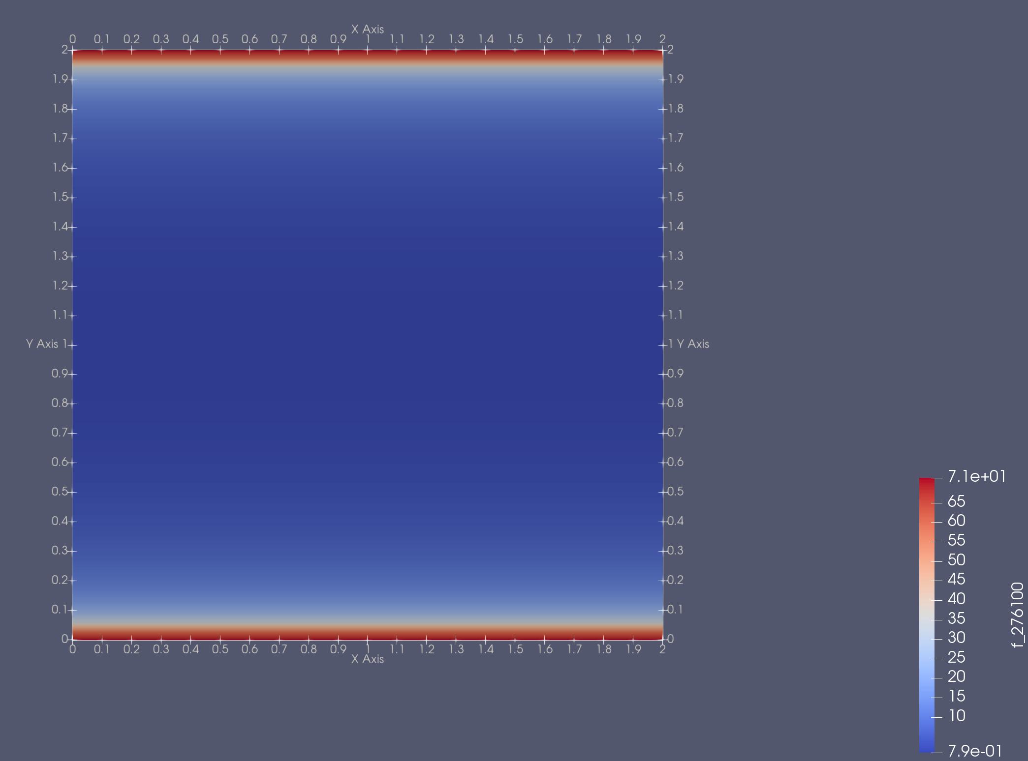
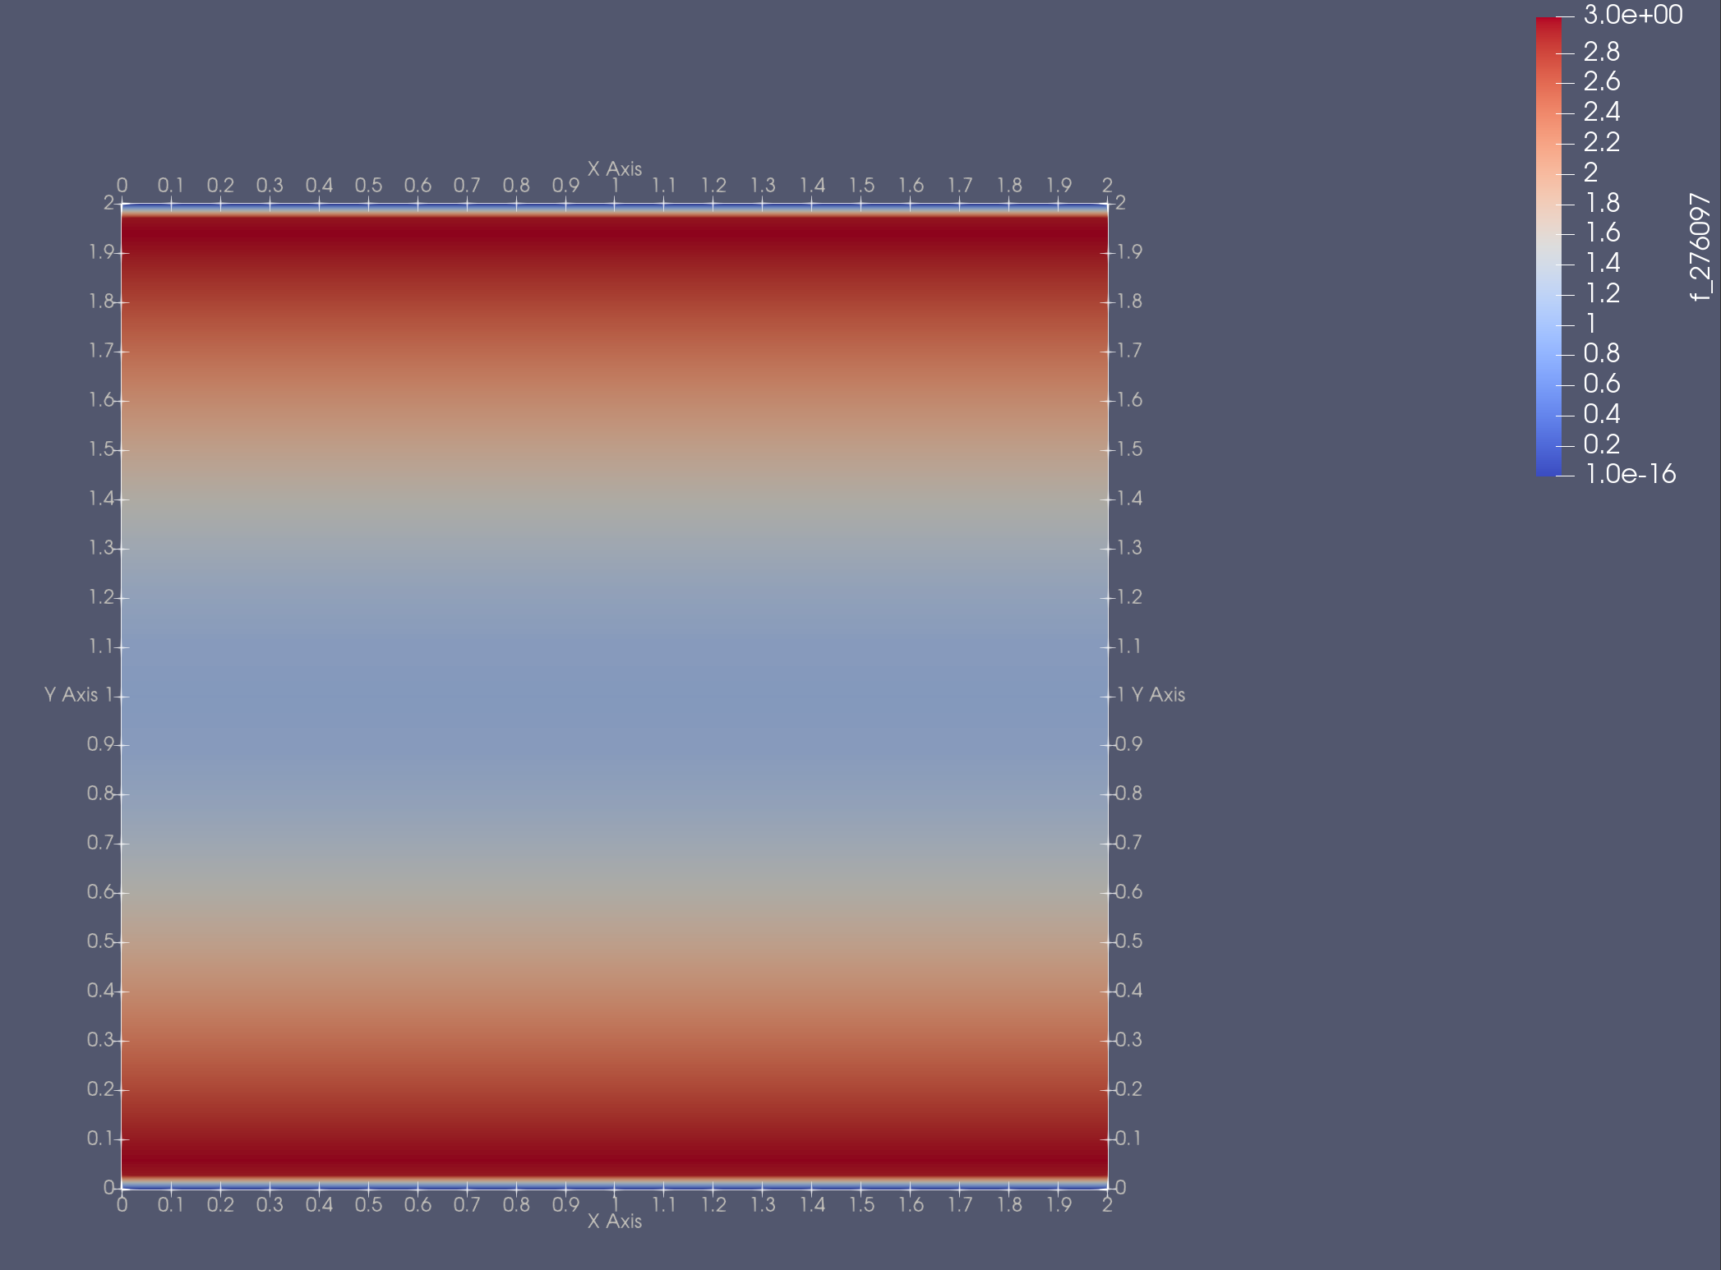
Implementation of k-epsilon model in FEniCS
Benchmark case 1: 2D fully developed channel flow
Visualization with ParaView

Slide 37
Implementation of k-ε model in FEniCS
Benchmark case 2: 2D flow over backward-facing step
Lam-Bremhorst k-ε model
Solver strategy: steady-state iterative RANS solver
Numerical scheme: monolithic solver ("coupled" approach)
MUMPS direct solver
Turbulence coupling: segregated
Notes:
Inlet velocity BC, outlet pressure BC, zero-velocity at wall, zero-k at wall

Slide 38
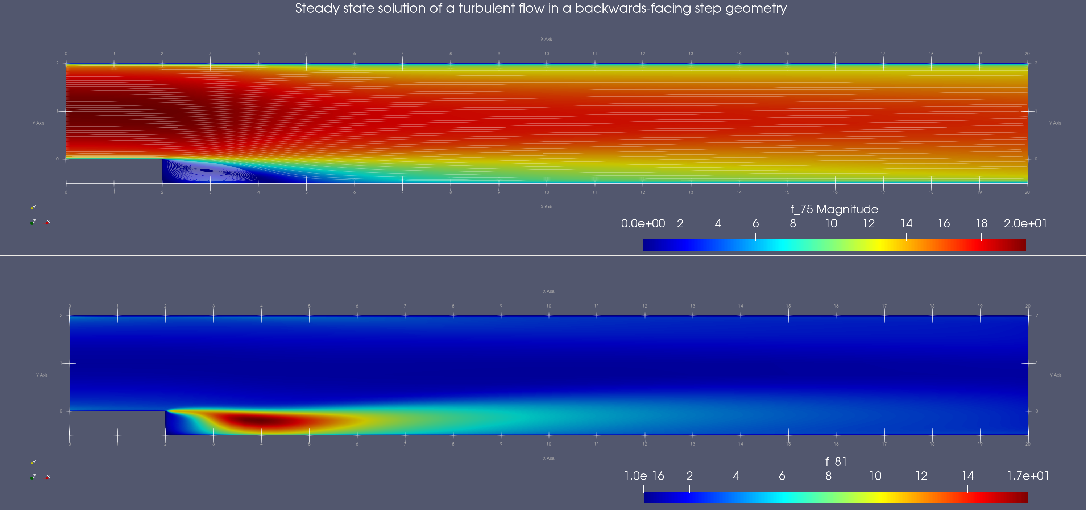
Implementation of k-ε model in FEniCS
Benchmark case 2: 2D flow over backward-facing step
Recirculation zone immediately after step, flow separation at x = 2m
Flow reattachment at x ≈ 6m

Slide 39
Implementation of Spalart-Allmaras model in FEniCS
Transport equation for modified eddy viscosity:
Eddy viscosity:
[17] Jessica Sari, Francesco Cremonesi, Mehdi Khalloufi, François Cauneau, Philippe Meliga, et al..
Anisotropic adaptive stabilized finite element solver for RANS models. International Journal for
Numerical Methods in Fluids, 2018, 86 (11), pp.717-736. 10.1002/fld.4475. hal-02115828

Slide 40
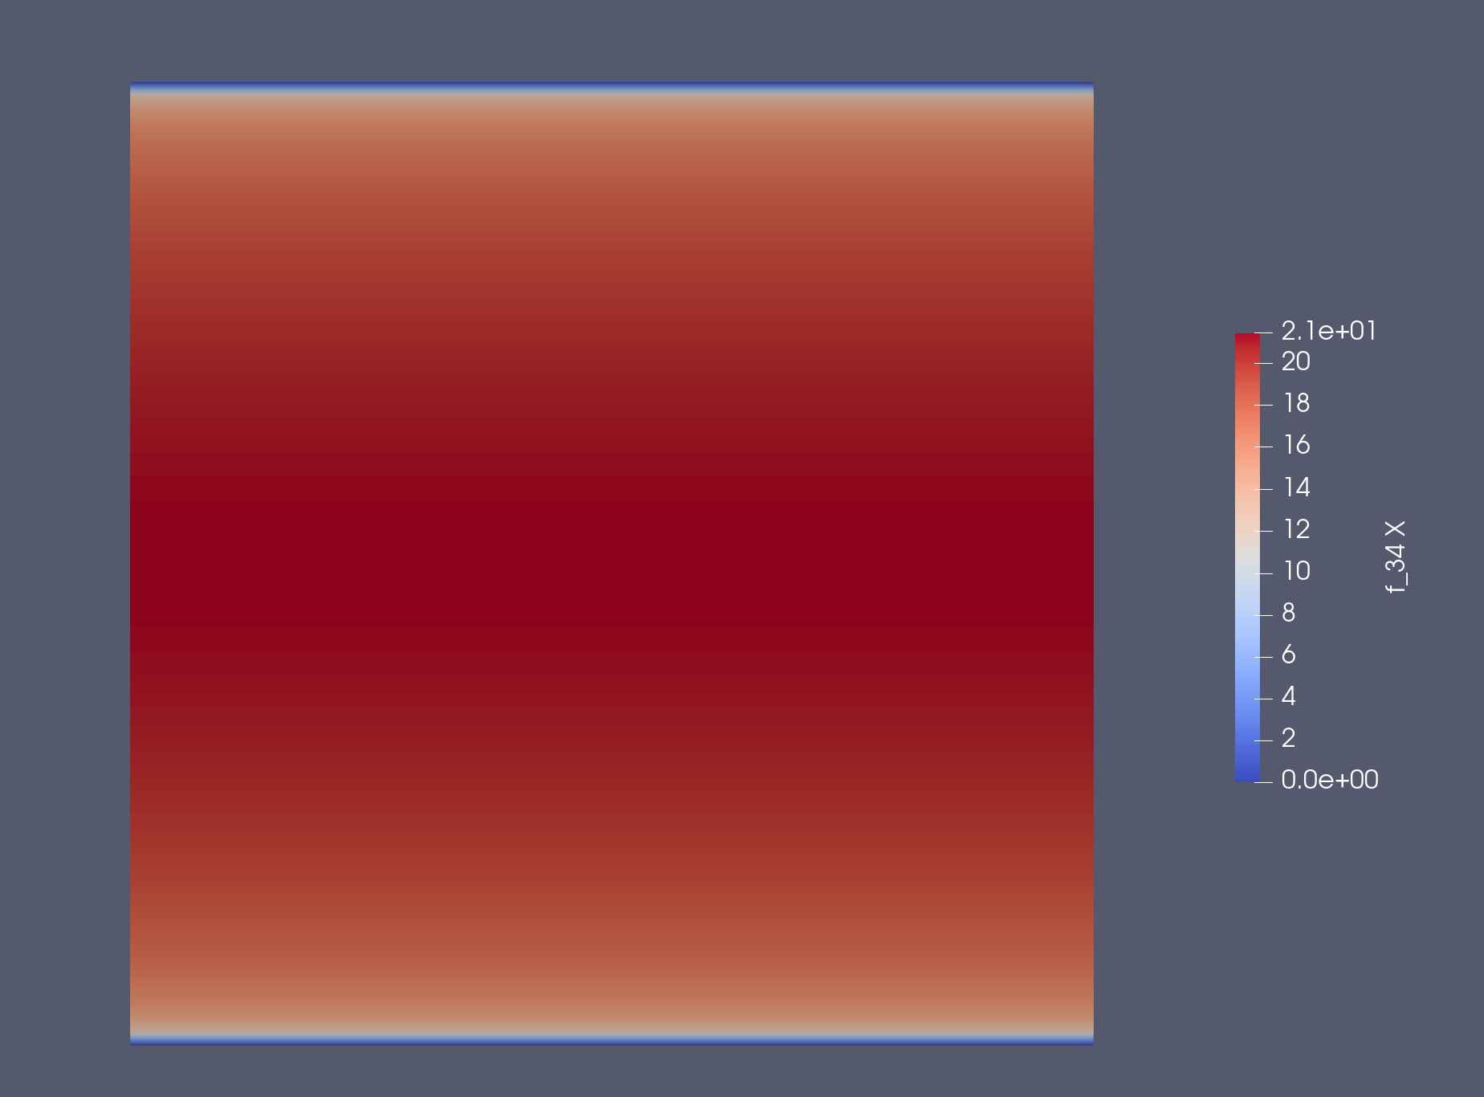
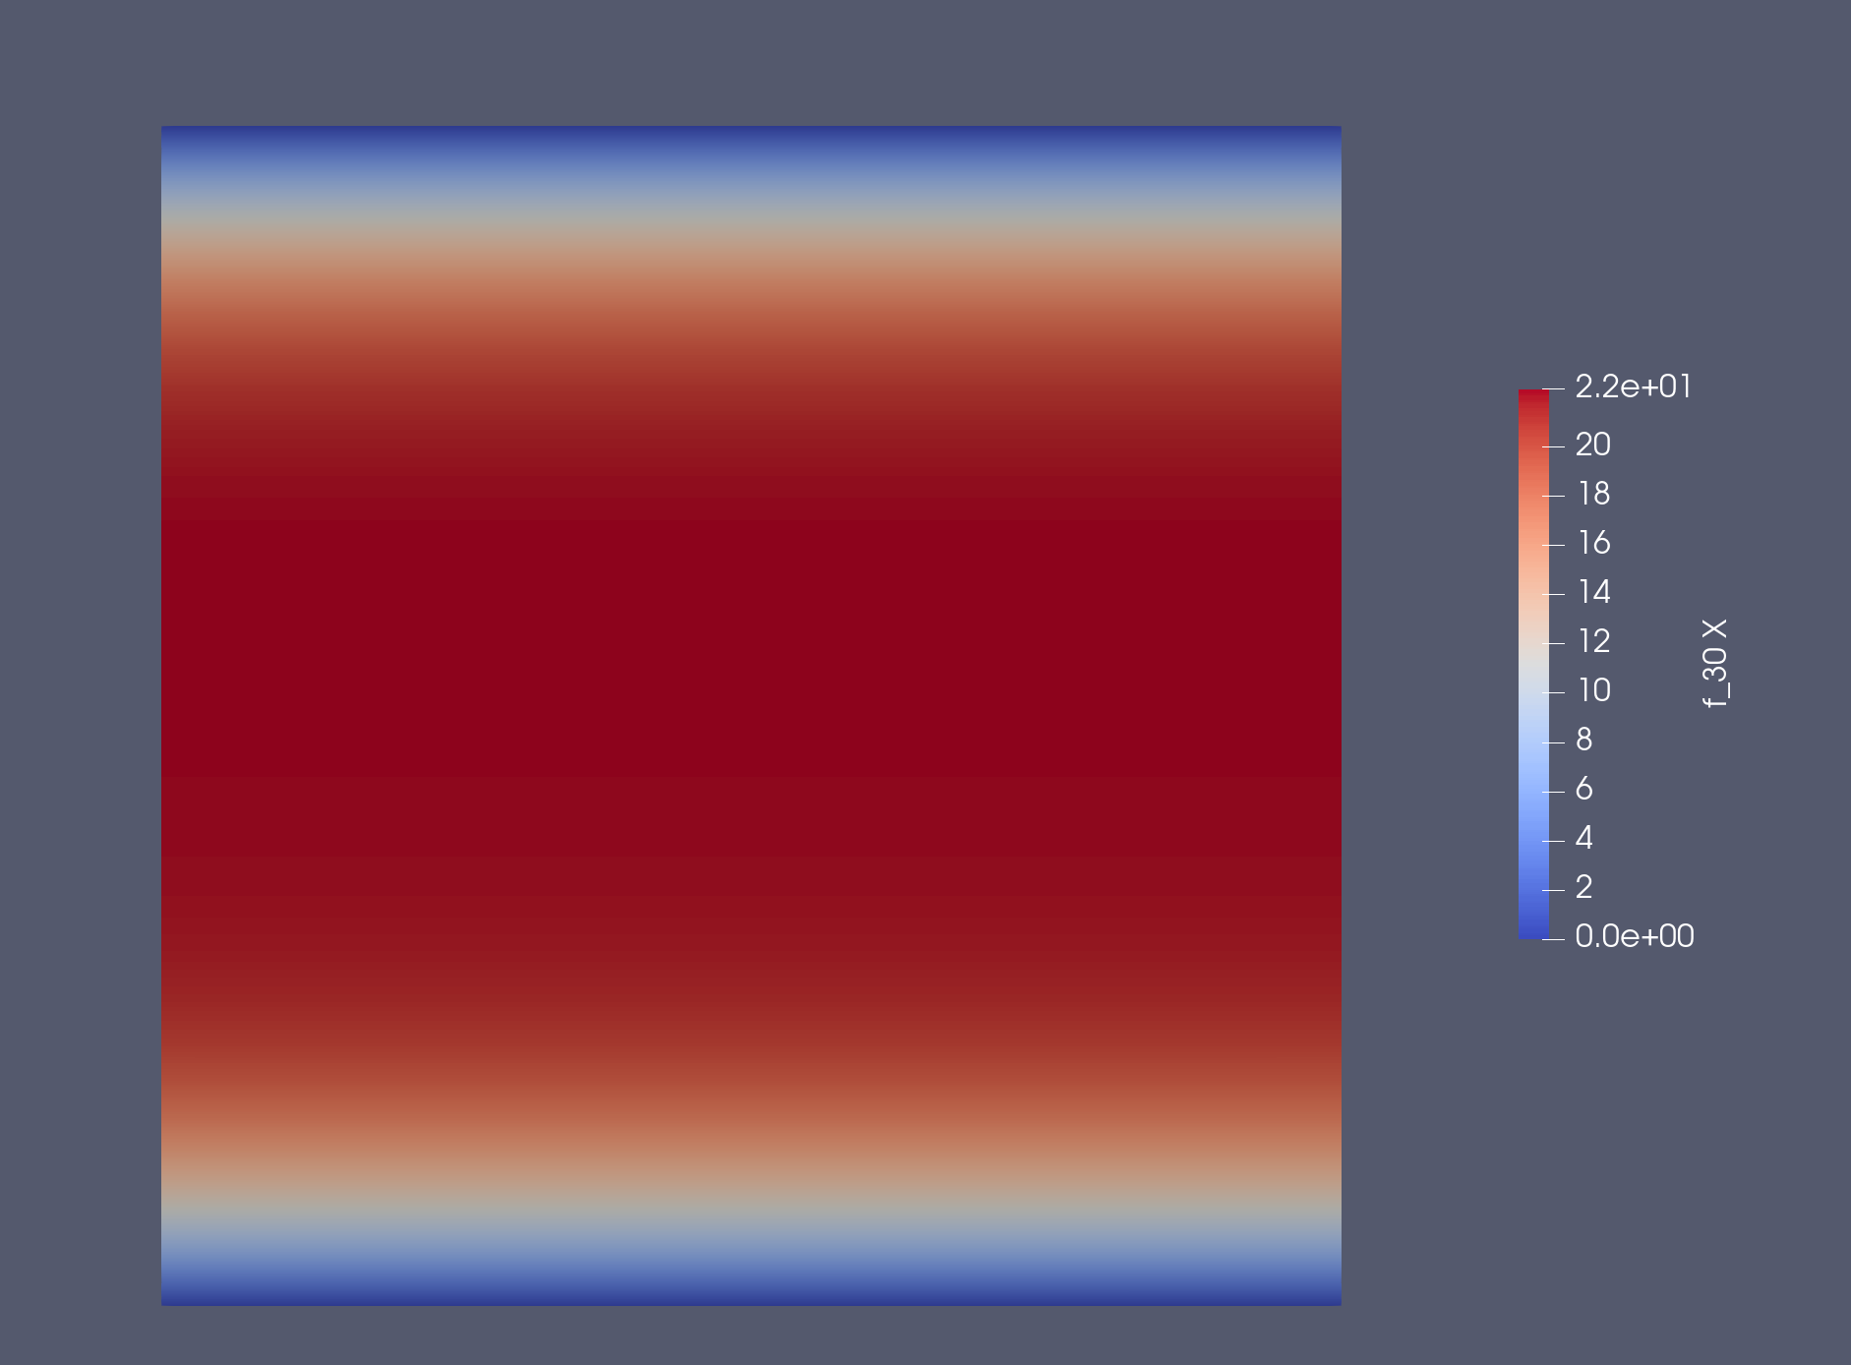
Implementation of Spalart-Allmaras model in FEniCS
Benchmark case 1: 2D fully developed channel flow
Implement initial & boundary conditions for modified eddy viscosity
Lam-Bremhorst k-ε: strong near-wall damping, low μ_{t}
SA: overpredicts mixing, weakens velocity gradients
Notes:
IC & BC for modified eddy viscosity nu_tilde
Nu_tilde = 0 at walls
Lam–Bremhorst: sharp near-wall gradient, thin viscous sublayer, minimal νₜ at the wall.
Spalart–Allmaras: more diffusive, fuller velocity profile, thicker near-wall velocity layer.

Slide 41
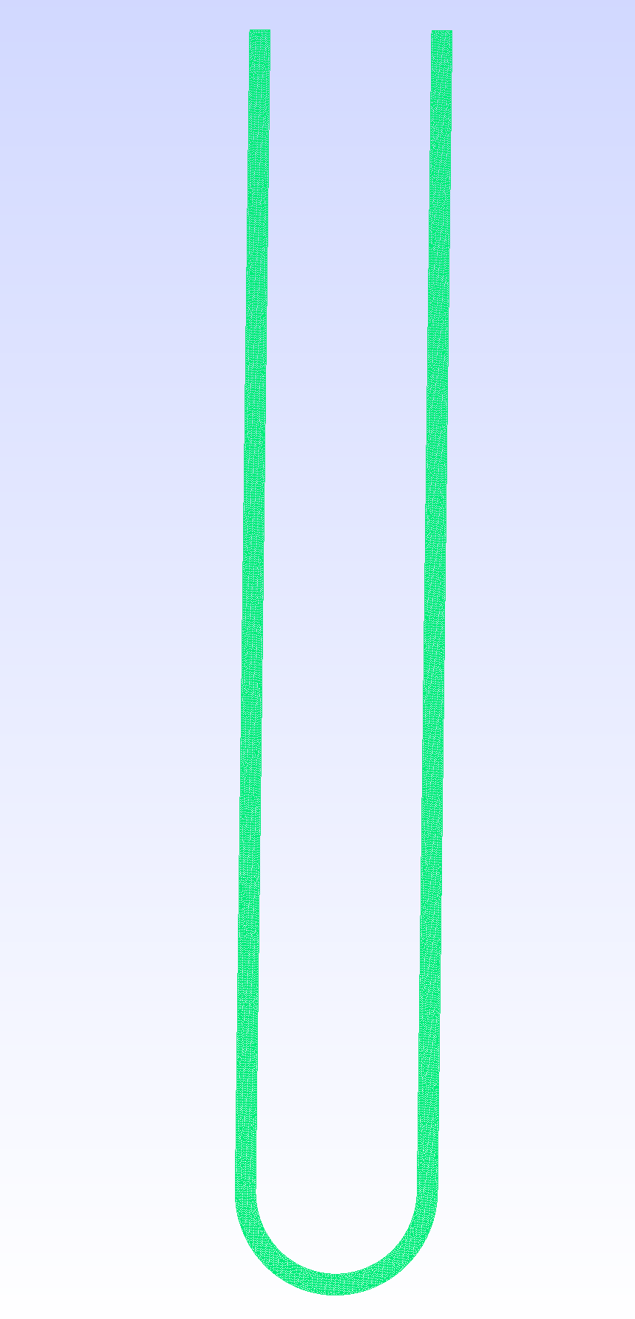
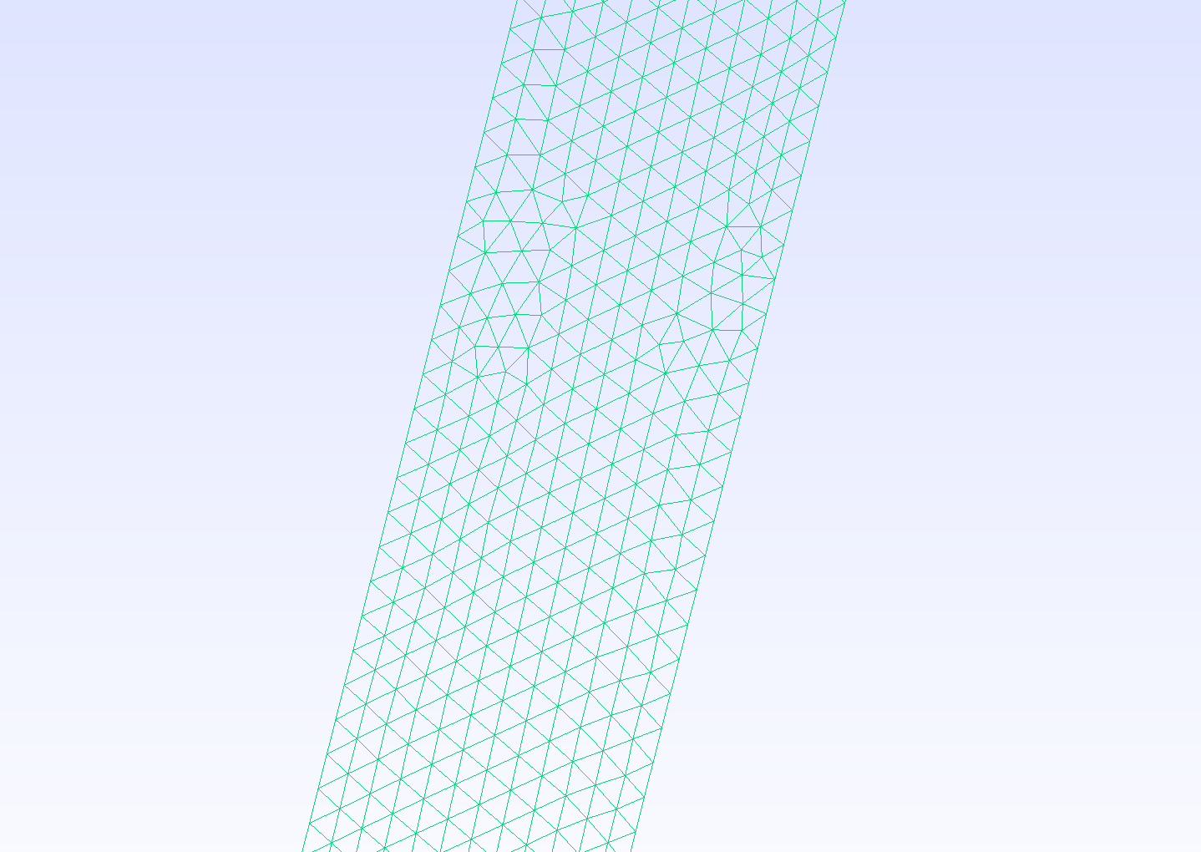
Implementation of Spalart-Allmaras model in FEniCS
Benchmark case 2: 2D U-bend (VMFL048)
Implement same geometry (R_{c}/D) & boundary conditions as ANSYS case
Meshing (GMSH)
Extend to 3D

Slide 42
Content
Motivation, research objective & research questions
Benchmark turbulent flow cases in Ansys
Introduction to turbulence modelling and FEniCS
Benchmark turbulent flow cases in FEniCS
Topology optimization in FEniCS
Timeline and summary

Slide 43
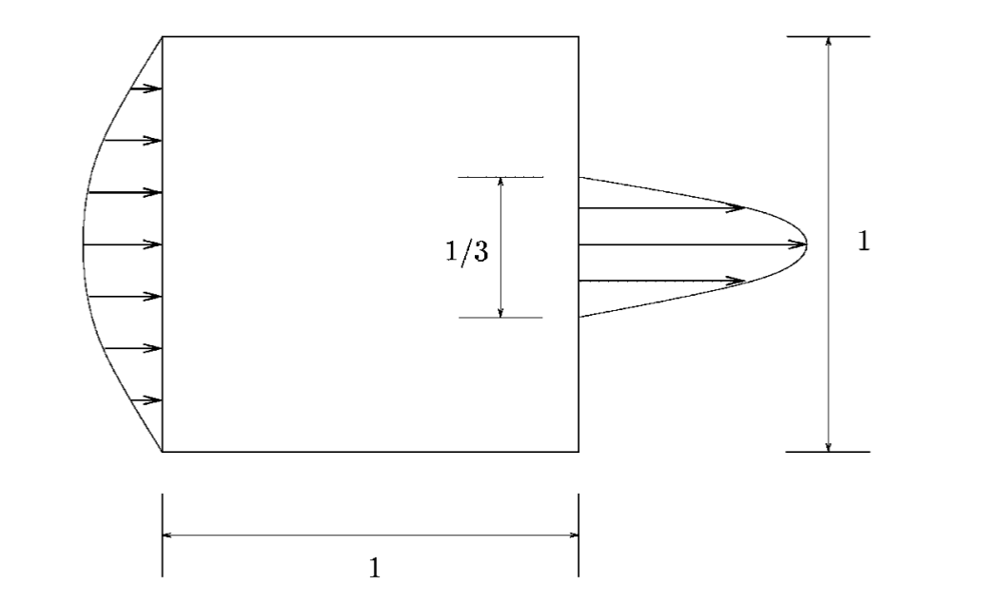
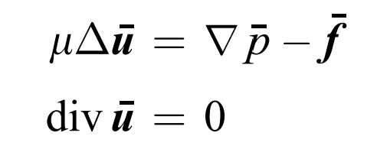
Topology optimization in FEniCS
Benchmark case: 2D laminar flow in diffuser
Design domain Ω, FEM
Incompressible Navier-Stokes equations
Slow, steady flow: neglect convection term + time derivative
Stokes equations:
[17] Borrvall, Thomas & Petersson, Joakim. (2003). Topology optimization of fluid in Stokes flow. International Journal for Numerical Methods in Fluids. 41. 77 - 107. 10.1002/fld.426.
Notes:
Inlet velocity BC, outlet pressure BC, no-slip wall velocity BC
For slow and steady flow, the convection term (∇u) u is neglected and the spatial time derivative vanishes. The Navier–Stokes equations then reduce to the Stokes equations.

Slide 44




Topology optimization in FEniCS
Density-based topology optimization: pseudo-density ρ ∈ [0;1]
Objective function J(ρ): dissipated power (min J)
Fluid volume constraint: V_{fluid} ≤ 0.50V_{design-space}
Gradient-based: compute gradient ∂J/∂ρ for each mesh element
Assign value of ρ to every mesh cell: solid (ρ=1), porous (0<ρ<1), fluid (ρ=0)
Notes:
Pseudo-density = only design variable Gradient-based method: negative gradient of pressure drop w.r.t. density: increase density (more solid)
Start from porous material (ρ = 0.5 everywhere)
The adjoint method makes gradient computation efficient: one adjoint solve gives gradients for all elements.

Slide 45
Turbulent topology optimization in FEniCS
Spalart-Allmaras turbulence model
SA requires wall distance field d(x)
Density-based TO used implicit walls ("grey zones", 0<ρ<1)
Problem: wall location and d(x) not explicitly known
Solution: density-dependent proxy for d(x) and eddy viscosity damping (μ_{t} → 0)
[18] Luís F.N. Sá, Paulo V.M. Yamabe, Bruno C. Souza, Emílio C.N. Silva, Topology optimization of turbulent rotating flows using Spalart–Allmaras model, Computer Methods in Applied Mechanics and Engineering, Volume 373, 2021, 113551, ISSN 0045-7825, https://doi.org/10.1016/j.cma.2020.113551.
Notes:
"Grey regions" between solid and fluid
In Spalart–Allmaras, the eddy viscosity νt must drop to zero at the wall, because turbulence cannot exist inside the viscous sublayer. SA uses damping functions that depend on d(x).
Viscosity must -> 0 as rho -> 1 (solid wall).
Otherwise SA behaves incorrectly in grey zones (producing turbulence inside “solid-like” regions)

Slide 46
Content
Motivation, research objective & research questions
Benchmark turbulent flow cases in Ansys
Introduction to turbulence modelling and FEniCS
Benchmark turbulent flow cases in FEniCS
Topology optimization in FEniCS
Timeline and summary

Slide 47
Research questions
For which benchmark turbulent flows (implemented in ANSYS) does the Spalart–Allmaras turbulence model provide sufficient accuracy, and where does it begin to fail?
Can a FEniCS implementation of the Spalart–Allmaras model reproduce reliable results for standard turbulent flow cases?
Does topology optimization using the Spalart–Allmaras model yield physically meaningful and robust turbulent flow designs?
Can topology optimization with SA be extended to turbulent conjugate heat-transfer problems while maintaining reliable performance?

Slide 48
Summary
Spalart-Allmaras turbulence model: reliable mainly for fully turbulent flows with mild curvature, losing accuracy as Dean number and curvature intensity increase
FEniCS framework: solution for NS and turbulence equations, weak formulations using FEM
Topology optimization approach: design domain Ω, objective function J, pseudo-density ρ
Ongoing work: implementation and verification of Spalart–Allmaras in FEniCS, extension toward turbulent TO, design verification against ANSYS
Notes:
FEniCS providing flexibility for custom turbulence and optimization models
TO enables systematic design of fluid domains under flow constraints

